Slide 1


Roberts Middle School
The Charger Way

Slide 2

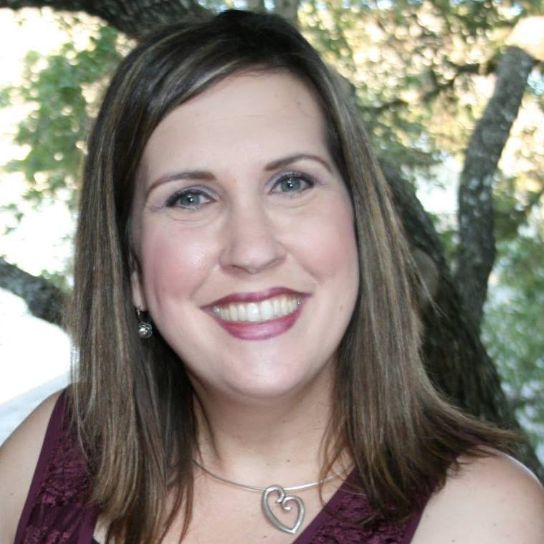
Ms. Harvey- 6th grade Principal
Ms. Antoine- 6th grade Assistant Principal
Ms. Barbee-6th grade Counselor

Slide 3
Daily Schedule
8:15-3:40
English Language Arts/Reading (block class 90min.)
Math
Science
Social Studies
Physical Education/Dance
1 Elective

Slide 4

Canvas provides you, as parents and guardians, “view only” access to see your child’s course work. You will have access to information about your child’s classes such as calendar reminders, announcements, assignments, class notes, and more. As LCISD teachers use Canvas throughout the school year, you will see valuable information inside of this tool.

Slide 5
Attendance
Under the Compulsory Attendance Law, Children within the compulsory school attendance age (6-18) must be in regular attendance in school.
Virtual Attendance-Students will be counted present in each class if they complete one of the indicators below:
  Worked in or completed a task in Canvas that day.
  Attended a zoom activity.
  Had a conversation with the teacher via email or phone call.

Slide 6
Excused vs Unexcused Absences
If your child is absent, please make sure you send a parent note to school or a doctors note if your child went to the doctor.
All notes need to be turned into your child’s first period teacher.
Virtual Students-the parent/doctor note should be emailed to your child’s first period teacher.

Slide 7
Transportation Changes
Please call the front office 832-223-5300 for a transportation change for your child. Please call by 3:00pm so we have time to notify your child.
  OR
Send a note with your child about a transportation change.

Slide 8
Keeping Grades Up
Failing your classes or failure to do homework, or receiving a zero on an assignment may result in assigned tutorials.
Grades can be accessed by parents and students at any time through Skyward. Please direct questions regarding grades directly to the teacher.

Slide 9
Tutorials
Students who are struggling in their classes should attend tutorials.
Please see your teachers for the set tutorial schedule. We will publish a campus-wide tutorial schedule in the first week of school.

Slide 10
Tardies
5 minute passing period
Dismissal from classrooms will be staggered.
Must be inside classroom
Absent after 15 minutes
Multiple tardies in a 6 weeks results in disciplinary action.
Occasional hall sweeps will be conducted.

Slide 11
Releasing of students will be staggered due to social distancing.
Car riders will exit only through the front doors.
Once outside, students will sit socially distanced from one another.
Roberts staff members will call students when their car arrives.
Please write your child’s name on a piece of paper to display in the passenger window for the first day of school.
Car Riders

Slide 12
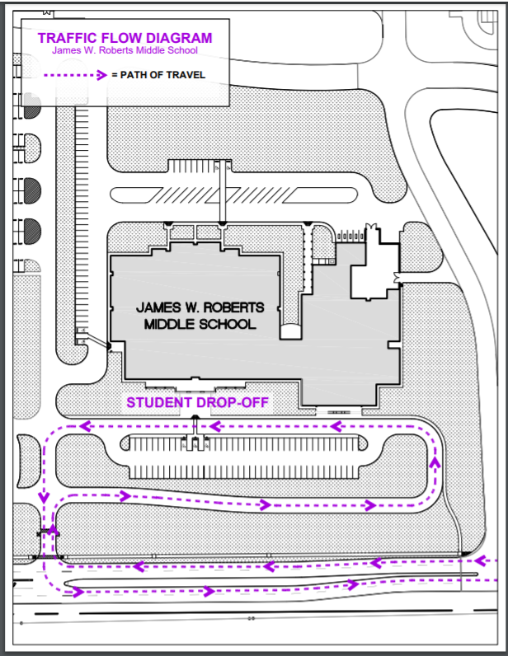

Slide 13
Bus Procedures
Students will stay in their 7th period class and listen/watch for their bus number to be called/displayed in the classroom.
A Roberts staff member will take attendance for each bus.
After attendance is taken, students will be escorted to their bus.

Slide 14

Bus Discipline
Listen to the bus driver’s instructions
Failure to comply with the driver’s instructions will result in discipline.
1st referral – off for 5 days
2nd referral – off for 10 days
3rd referral – off 20 days
4th referral – remainder of
school year

Slide 15
Medications and Vaccinations
Sick children must be fever free (less than 100°) for 24 hours without use of medications before returning to school. Notify us of contagious illnesses.
Students cannot carry medication at school, including cough drops. Bring medications to Ms. Stubbs and she will administer them. They must be in the original container and you must sign a medication form.
Medications taken once a day should be taken at home; please see Nurse Stubbs for exceptions.
Provide written medical documentation of food allergies (see Ms. Stubbs for the form) along with a photo of your child.
We need Action Forms from your child’s physician for the following diagnosis:
  Asthma
  Diabetes
  Seizures
Heather Stubbs, LVN
832.223.5306
Heather.HoganStubbs@lcisd.org

Slide 16

Secondary
Student Code Of Conduct
www.lcisd.org/students-parents/

Slide 17
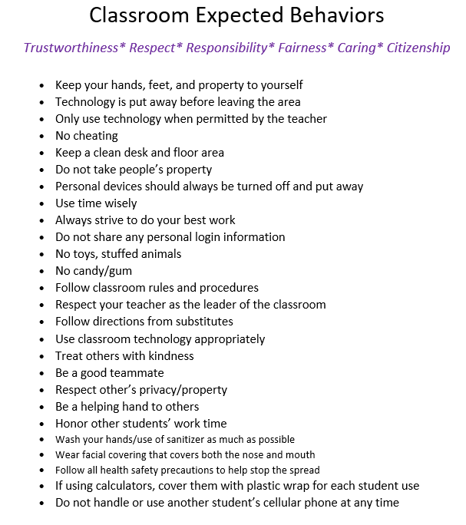
Follow Classroom Rules

Slide 18
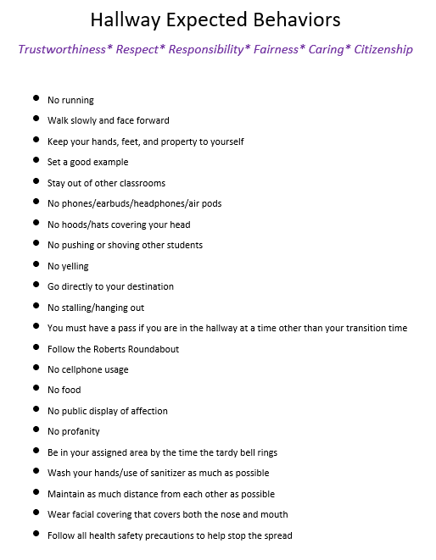
Hallway Behavior

Slide 19
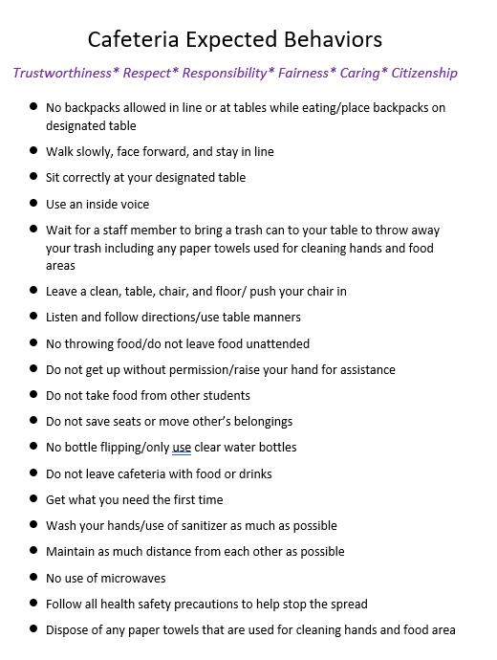
Cafeteria Behavior

Slide 20
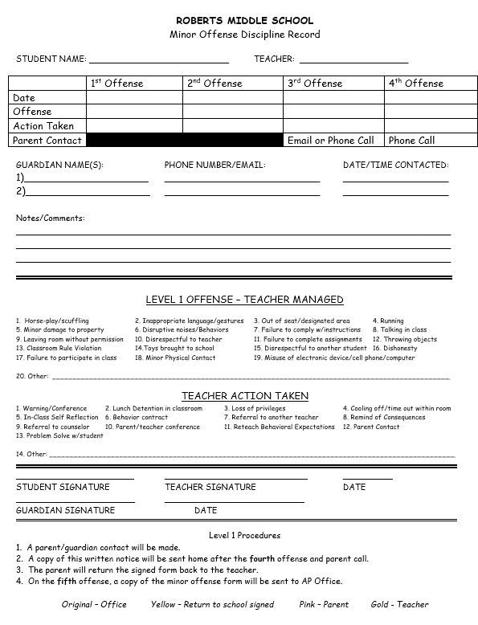
Minor Offense Discipline Record

Slide 21




No Food or Drinks in Classrooms

Slide 22
Electronic Devices
All students selecting virtual instruction will have the option to use their own device or checkout a Lamar CISD student laptop.
All students selecting on-campus instruction are encouraged to bring their own electronic device.
On-campus students will share campus devices if they do not have their own personal device. Students will learn how to sanitize technology devices before they use one and after they finish using it.

Slide 23
Electronic Devices
If opting to use a personal device, the device should meet the following requirements:
Minimum screen of at least 9.7” or larger
Modern Operating System
  Window 7 or newer
  MacOS 10.12 or newer
  iOS 11.0 or newer
Memory: 2GB of RAM
Hard Disk Space: 200MB of free hard disk space
Google Chrome web browser
Webcam/self-facing camera
Microphone

Slide 24
Cell Phone
Policy
Lamar CISD believes that appropriate use of students’ technology devices enhances our students’ education. Students may use devices in class at the teacher’s discretion. Students must follow teacher, campus, and district rules.
Students must adhere to the following rules regarding cell phone use:
Cell phones must be turned off and cannot be visible on campus during the school day. Students may use devices in class only at the teacher’s discretion.
Placing a cell phone on vibrate or texting is not considered off and is prohibited.
Using a cell phone to record or video tape is prohibited.
Ear buds, speakers, radios, MP3 players, video or audio recorders, DVD players, cameras, games or other electronic devices should only be visible in the classroom at the teacher’s discretion.
If a student needs to make a phone call to parents or guardians, they may do so in the Front Office.

Slide 25
Cell Phone Policy
FIRST OFFENSE • The cell phone will be confiscated and returned to the student at the end of the school day.
SECOND OFFENSE • The cell phone will be confiscated; parent phone call and cell phone will be returned to the student at the end of the day.
THIRD OFFENSE • The cell phone will be confiscated and returned to a parent or guardian after a mandatory parent conference.
FOURTH OFFENSE • The cell phone will be confiscated and returned to a parent or guardian after the monetary payment. • In accordance with Texas Education Code 37.082 a $15 administrative fee will be collected.

Slide 26
Unacceptable and Inappropriate Use of Technology
Please refer to the LCISD Secondary Student Code of Conduct.

Slide 27

Roberts is a Bully Free Zone
No Place for Hate-Character Counts Club

Slide 28
What is Bullying ?
A single significant act or pattern of acts by one or more students directed at another student that exploits an imbalance of power and involves engaging in written or verbal expression, expression through electronic means, or physical conduct.

Slide 29
What does Bullying look like?
Acts of bullying can be physical or verbal.
1) Physical bullying such as kicking or pushing
2) Verbal bullying such as name-calling or yelling
3) Relational bullying such as excluding or rumor-spreading
4) Cyberbullying which involves sending hurtful messages
over digital devices like computers and cell phones

Slide 30
Prohibited Items
Toy guns/BB guns/ Air guns
Knives of any kind
Lighters
Pepper Spray or Mace
Laser Pointers
Dice
Chains
Shocking Devices
Drug paraphernalia

Slide 31

No Permanent Markers
Allowed on Campus

Slide 32


No Glass Bottles of Cologne or Perfume

Slide 33
Student Dress Code
The established purpose of a dress code policy is to minimize the disruption or interference of the educational process and normal school operations.
A student who violates dress code shall be asked to change.
A parent or designee can bring an acceptable change of clothing to the school.

Slide 34
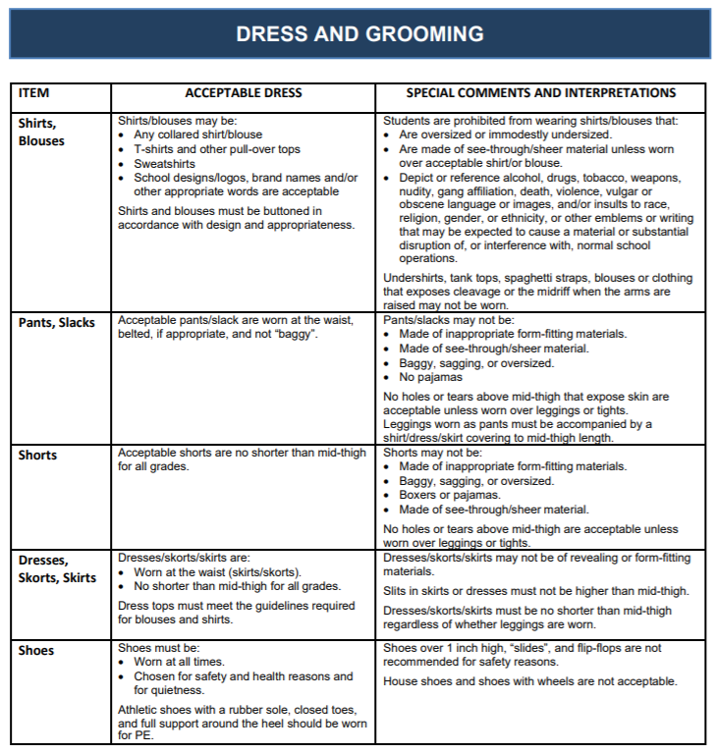

Slide 35
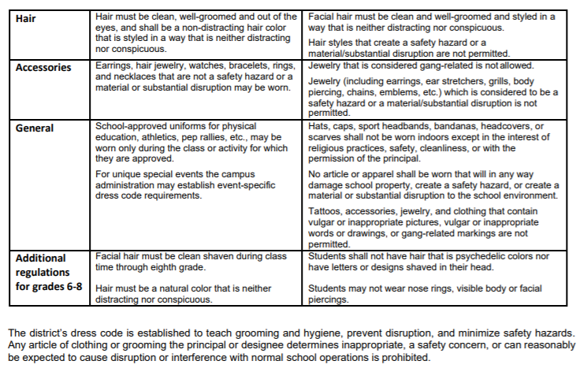

Slide 36

Additional Help
If you have any questions regarding the student code of conduct, you can contact any administrator.

Slide 37
Things To Do
Review ‘The Charger Way’ power point with your child.
Have your child complete the Let’s Get to Know You-Student Survey.
Watch ‘Meet the Staff’ video.
Watch the virtual campus tour.
Review Supply List.

Slide 38
Thank you for viewing!

