Slide 1
Lamar junior high
2020-2021 Orientation

Slide 2
Daily Schedule - 8:15-3:40pm
7th Grade
English Language Arts/Reading (block class 90min.)
Math
Science
Social Studies
Physical Education/Athletics
1 Elective
8th Grade
English Language Arts/Reading Math
Science
Social Studies
Physical Education/Athletics
2 Elective

Slide 3
DAILY WORK AND LEARNING ENVIRONMENT
(
General Building​
Signage posted, directional signs for students transitions, social distancing.​
No student lockers.​
Constant review of student practices and proactive responses.​
Daily Schedule-Arrival, Breakfast, Transitions, Lunch, Dismissal​
Procedures clearly designed to achieve social distancing in all of the above. ​
Staff duty schedule to provide supervision in areas as needed. ​
No microwaves, Grab and Go food, no change made.​
Schedule time to disinfect between lunches. ​
Volunteers, Visitors, and Deliveries​
Campus closed to non-essential visitors, parents, volunteers, and external groups or organizations. ​
Virtual appointments and meetings with limited pre-arranged face to face visits. ​
Public Service providers, essential vendors, and contractors may be allowed in after responding to COVID Symptom Screening.​

Slide 4
Building procedures
Signs about Covid-19 will be visible around the building.
All staff will be provided 5 cloth masks.
Lamar JH staff will be provided an additional plastic face shield.
All staff and students will be required to wear a face covering on school grounds (except when actively eating or drinking) when appropriate social distancing can not be maintained. (mask, shield, neck buff)
Students who arrive without a face covering will be given a mask.
The school will accept a medical release for students who can not wear a face covering.

Slide 5
Building procedures
Notes between staff and parents/guardians can be done
Electronically (email, Class Dojo, Remind 101)
Phone
Written Notes
We strongly encourage parents not to have deliveries sent to school for students because delivery visitors are not permitted into the building.
No field trips are permitted at this time.

Slide 6
School ID’s and Smart Tags
All On Campus students will be required to wear their lanyard with their Smart Tag and ID on campus.
Each student will be given a lanyard with their tag.
Due to Covid Contact tracing IDs are required at LJH

Slide 7
PROTOCOLS FOR CAMPUS VISITORS
All District campuses will be closed to nonessential visitors, parents, volunteers and activities involving external groups or organizations for the first semester. Campuses will utilize virtual meetings and electronic communications when necessary.
After the first semester, all visitors who enter the building will be required to wear a face covering during HIGH, MODERATE, and LOW Risk Levels.
Individuals who proceed beyond the reception area will follow specific guidelines for visitors, based on the District’s risk level protocols.

Slide 8
VISITOR AND VENDOR SCREENING
All individuals entering the building will be required to wear face coverings during HIGH, MODERATE, and LOW Risk Levels.
Individuals proceeding beyond the reception area will be subject to the following guidelines:
All visitors will be subject to screening by way of a symptom screening form.
Virtual meetings will be available when possible.
Visitors and staff will maintain physical distancing for ARD and other meetings in smaller conference areas.

Slide 9
Health Guidelines
(
Notification that a staff member or student has tested positive for Covid-19 will be issued by the LCISD Communications Department in conjunction with Lamar Junior High.
The school district and campus will conduct social tracing when suspected cases arise.
A 14-day home isolation period will be required of any staff member or student who tests positive for Covid-19 and anyone who is determined to have been in direct contact as determined by the LCISD Policy.
Students who test positive of Covid-19 and are placed on quarantine will be placed on remote learning during the isolation period.

Slide 10
Health Guidelines
Parents will self-assess students with the Covid-19 District Checklist before sending them to school each morning.
Staff will self-assess using the Covid-19 District Checklist daily.
Staff and students will stay home if they have a fever of 100 ⁰F or higher.

Slide 11
Sick Clinic
The nurse office will be the designated quarantine room.
The maximum capacity will be 4 students.
Barriers will be placed between students for additional protection.
Students that are sent to the nurse with possible symptoms will go to the quarantine room.
The nurse will check symptoms before they enter the room.
If it is determined they need to quarantine, the nurse will stay in the room while office staff calls home.
If it is determined they are ok to return to class, they will return to class.

Slide 12
Well Clinic/Vaccinations/Medicines
The Well Clinic will be located in the Library Workroom.
Students will access daily medicine from the Well Clinic.
Sick children must be fever free (less than 100°) for 24 hours without use of medications before returning to school. Notify us of contagious illnesses.
Students cannot carry medication at school, including cough drops. Bring medications to Nurse Garza and she will administer them. They must be in the original container and you must sign a medication form.
Medications taken once a day should be taken at home; please see Nurse Garza for exceptions.
Provide written medical documentation of food allergies along with a photo of your child.
We need Action Forms from your child’s physician for the following diagnosis:
Asthma
Diabetes
Seizures
Charae Garza, RN
832.223.3215
charae.garza@lcisd.org

Slide 13
Return to school/work guidelines​
Anyone with a lab confirmed COVID-19 positive case OR individuals who meet the definition of close contact and at-risk exposure may return to school or work when the following criteria are met:​
​
The individual is fever free for 24 hours without the use of fever reducing medications AND there has been improvement in symptoms. (EX- cough, shortness of breath, senses of taste and smell has returned) AND at least 10 days have passed since symptoms first occurred​
OR​
2. A release to return to school/work is provided by a medical provider​
OR​
3. The individual provides two negative tests at least 24 hours apart​
OR​
4. The 14-day quarantine expires with no signs of illness. *this only pertains to individuals at-risk of exposure​
​
Students and staff who come in close contact with a COVID-19 positive individual ​
will be asked to self-quarantine for up to 14 days and may not return to campus during this time. ​

Slide 14
Close contact and Exposure Guidelines​​
When a student or employee notifies the District that they have received a positive test result for COVID-19, the District will work with the employee or student to identify all individuals who are at risk for exposure.​
​
An individual who meets the following criteria will be considered in close contact and having at-risk exposure:​
Close Contact Criteria​
Being within 6 feet or less for a cumulative duration of 15 minutes; however additional factors may affect determination whether it is considered close contact ie. Both parties consistently and properlymasked, ventilation, presence of dividers and case symptomology. OR​
Being directly exposed to infectious secretions (ex- being coughed or sneezed on while not wearing a mask or face shield)​
If either of the above occurred at any time in the last 14 days when the infected individual was considered infectious (at least two days prior to the onset of symptoms or two days prior to the test forasymptomatic individuals)​

Slide 15
COVID-19 RISK LEVELS​
HIGH RISK Mask Required
High potential for exposure to known or suspected sources of COVID-19.
MODERATE RISK Mask Required
High potential for exposure to known or suspected sources of COVID-19.
LOW RISK Mask Required
Frequent/Close contact with people who may be infected but who are not known to be infected.
NEW NORMAL Mask Optional
Minimal and controlled level of COVID-19 new chains of transmission have been limited.

Slide 16
PROTOCOLS FOR FACE COVERINGS​
Protective measures, including the use of face coverings, will be determined by the risk level of COVID-19. The District will rely on data from the Department of State Health Services (DSHS), Fort Bend County Health & Human Services and the Centers for Disease Control (CDC) to determine the risk level and the appropriate protective measures. The risk level categories below are based on the recommendations of Fort Bend County Health and Human Services. The District will alert students, parents and staff of the weekly COVID-19 risk level and when face coverings must be worn.
Students’ individual needs will be addressed on a case-by-case basis. Parents who request an accommodation will need to submit a note from a physician to the campus nurse exempting the student from wearing a face covering.

Slide 17
Acceptable Face Coverings in Lamar CISD​
Non-medical and medical grade disposable face masks
Cloth face coverings over the nose and mouth
Neck gaiters that cover the nose, mouth, and neck
Per the latest TEA update: full face shields may be worn in place of a mask to protect eyes, nose, and mouth whenever a mask is NOT feasible. OR whenever the education context may benefit from the ability to see an individual’s full face. Recommended face shields wrap around the sides of the wearers face and extend to below the chin.

Slide 18
Student Expectations
Students in 4th through 12th grade will wear face coverings during HIGH, MODERATE, and LOW Risk levels, including in the classroom.
Students' individual needs will be addressed on a case-by-case basis.
Requests for accommodations will have to include a note from a physician and should be submitted to the school nurse.
Students are required to bring two dress code approved masks/face coverings daily. One will be worn, and one additional mask/face covering will be brought in a sealed/Ziploc bag. Labeling of the masks with a student name is suggested. Cloth masks should be washed daily, and paper masks should be discarded daily.

Slide 19
PROTOCOLS FOR DISINFECTING AND HAND SANITIZING
Frequent disinfection and hand sanitization will promote health and wellness of students and staff.
Hand Washing/Sanitizing Expectations
Hand sanitizer will be available at the main entry to the campus, in classrooms, in office areas, in the cafeteria, outside of the nurse’s clinic and in common areas throughout the campus.
Staff will be expected to regularly wash or sanitize their hands.
Requirements for hand washing and/or use of Lamar CISD-provided hand sanitizer:
MS/HS: Provide hand sanitizer upon entry to classroom and periodic teacher reminders during instructional day
MS/HS: Thorough hand washing upon return from outdoors, before and after eating, following restroom breaks, before and after using shared supplies (i.e. technology, instruments)
Disinfecting Expectations
Staff will have access to disinfectant wipes to sanitize high-touch and working surfaces and shared objects regularly.
Staff will limit the use of shared supplies when possible.

Slide 20
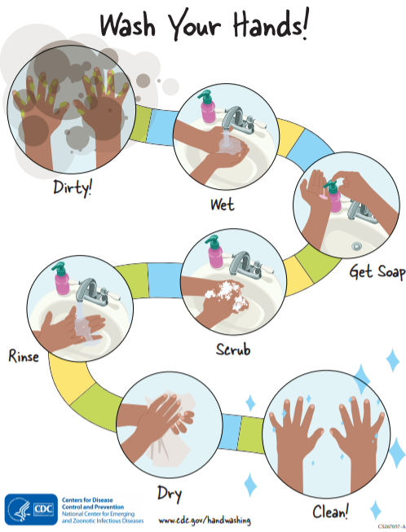
Hand Washing
Wet your hands with clean, running water (warm or cold), turn off the tap, and apply soap.
Lather your hands by rubbing them together with the soap. Lather the backs of your hands, between your fingers, and under your nails.
Scrub your hands for at least 20 seconds. Need a timer? Hum the “Happy Birthday” song from beginning to end twice.
Rinse your hands well under clean, running water.
Dry your hands using a clean towel or air dry them.

Slide 21
cleaning
Bathrooms will be cleaned on a schedule.
PE/Athletic equipment will be disinfected between each grade level.
Cafeteria tables will be disinfected between each lunch shift.
Classrooms will be disinfected nightly.
Additional cleaning supplies have been purchased for the school and classrooms.

Slide 22
Additional Cleaning Measures for COVID-19 Positive Cases on Campus
If a classroom or facility is closed due to COVID-19 spread, quaternary (hospital grade) disinfectant, which is recommended for use on the virus that causes COVID-19, will be used to disinfect.
Maintenance and Operations staff will disinfect and sanitize classrooms, restrooms, athletic facilities, and all additional areas in the building.

Slide 23
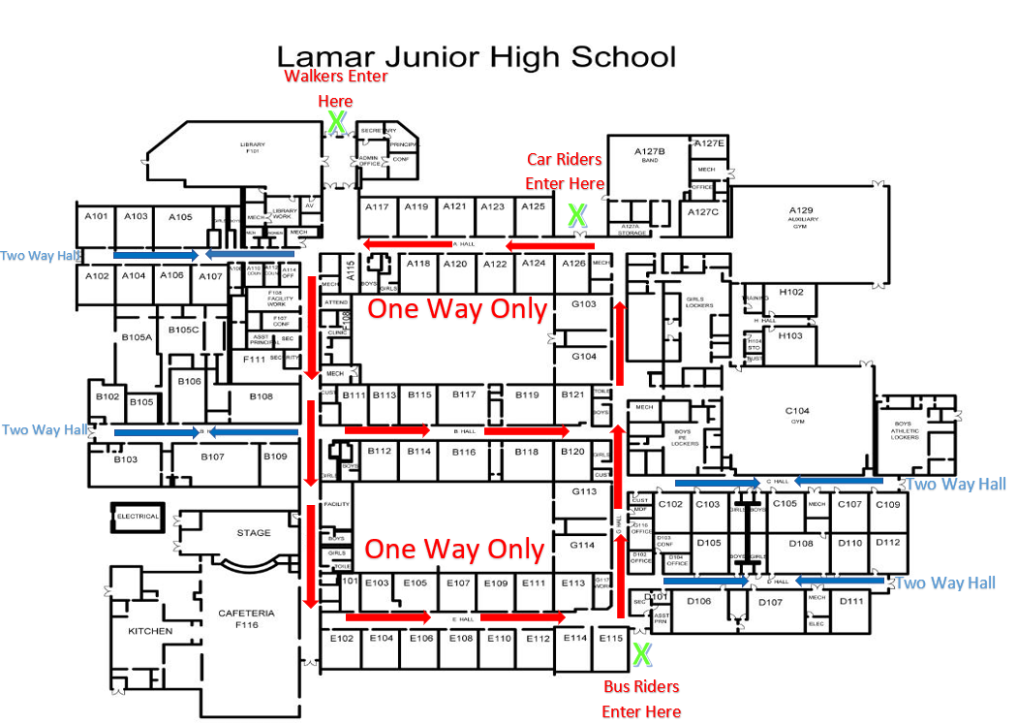
Hallway Traffic Patterns/Arrival Locations
Students will travel in a ONE WAY hall pattern to minimize contact.

Slide 24
bathrooms
A limited number of students will be permitted in the bathroom at one time.
Bathrooms Max Occupancy – 2 students at a time
Bathrooms will be cleaned
Before school, before lunch, after lunch, end of the day, in the evening
Between periods

Slide 25
Water fountains
All students should bring a refillable water bottle.
Limited water fountains will be used as refill stations only.
Students will hand sanitize after filling up their water bottles.

Slide 26
Backpacks/bags
ALL On Campus students will need to bring a BACKPACK to school to carry their belongings. There will be NO storing of items in any teachers classrooms.

Slide 27
Attendance
Under the Compulsory Attendance Law, Children within the compulsory school attendance age (6-18) must be in regular attendance in school.
Virtual Attendance-Students will be counted present in each class if they complete one of the indicators below:
Worked in or completed a task in Canvas that day.
Attended a zoom activity.
Had a conversation with the teacher via email or phone call.

Slide 28
Excused vs Unexcused Absences
If your child is absent, please make sure you send a parent note to school or a doctors note if your child went to the doctor.
All notes need to be turned into Mrs. Enax in the Attendance Office.
Virtual Students-the parent/doctor note should be emailed to your child’s first period teacher.

Slide 29
Morning arrival
Lamar JH will open our doors at 7:30AM.
Front entrance doors will be open for WALKERS to enter the building.
Band entrance doors will be open for CAR RIDERS to enter the building.
Bus Porch entrance doors will be open for BUS RIDERS to enter the building.
All staff and students will use hand sanitizer as they enter the building.
Only staff and students will be permitted in the building.
Visitors will be limited to emergencies and enrollment.

Slide 30
Breakfast/Morning Arrival
Students arriving between 7:30am-7:45am wanting breakfast will be directed to the cafeteria.
Students arriving between 7:30am-7:45am NOT wanting breakfast will be directed to the gyms:
8th Grade Performance Gym
7th Grade Auxiliary Gym
Teachers will be on duty to maintain social distancing.
Students arriving after 7:45am wanting breakfast will be directed to their 7th Period Class for homeroom and then will be released to grab breakfast.

Slide 31
Morning arrival
Staff will be on duty to monitor students and social distancing.
Late Arrivals will be entered into the attendance system by front office staff. Parents will not enter the building.

Slide 32
Classroom procedures
Students will hand sanitize as they enter the classroom.
Attendance will be taken daily in both traditional and remote learning.
Staff and students will wear face coverings during classroom instruction when appropriate social distancing can not be maintained.
Classroom doors will be open to minimize contact and provide air flow.
Classrooms will be free of clutter and excess furniture to allow for regular deep cleaning and sanitization.
Students will have assigned seats in the classroom.

Slide 33
Classroom procedures
Classrooms will be cleaned and sanitized frequently.
Classrooms will be furnished with additional hand sanitizer and disinfectant wipes for staff and students.
Classrooms will be set up to ensure maximum safety, following social distance guidelines to the greatest extent possible.
When possible tables and desks will face the same direction, so students are not facing one another.

Slide 34
End of Class procedures
2 minutes until the bell, students will be given a disinfectant wipe to wipe down their desk and chair
Students will throw away the wipe in the trash
Teacher will then provide hand sanitizer to student to clean their hands before leaving the classroom.

Slide 35
Instruction
Families may choose on campus instruction or virtual learning.
Expectations and grades for all learning models will be the same regardless of their learning environment.
Failing your classes or failure to do homework, or receiving a zero on an assignment may result in assigned tutorials.
Grades can be accessed by parents and students at any time through Skyward. Please direct questions regarding grades directly to the teacher.

Slide 36
Classroom configuration & Procedures
Furniture that is not essential to learning will be removed to free up space in the classroom. ​
Student seating will be arranged to best support social distancing when instructionally possible and each teacher will maintain a current student seating chart. ​
Desks will be numbered and the same numbers could be used for computers, iPads, manipulative sets, class set textbook, lab table assignments, etc. ​
Whenever possible, teachers will create station areas and routines that minimize movement around the classroom. Partner activities are permitted but teachers should use consistent pair groupings as much as possible. ​

Slide 37
Virtual Learning
Canvas provides you, as parents and guardians, “view only” access to see your child’s course work. You will have access to information about your child’s classes such as calendar reminders, announcements, assignments, class notes, and more. As LCISD teachers use Canvas throughout the school year, you will see valuable information inside of this tool.

Slide 38
Virtual learning
Electronic devices have been set for all students requesting technology assistance. If a student does not have a personal device the staff will work with the student to develop a plan of action.
Remote learning students must complete and follow our acceptable use agreement.
Daily intentional instruction expectations are 45-55 minutes for all assigned content areas including PE/Athletics. Synchronous instruction will occur twice a week. The remaining days will be spent doing asynchronous instruction and assignments.

Slide 39
Virtual learning
Direct contact between the teacher and student will be scheduled at least once twice week.
Teachers will be available between the hours of 8:15am-3:40pm Monday-Friday, excluding days when school is not in session, according to their conference period or by appointment.
Remote lessons/ assignments will be comparable across all learning environments and time equivalent to the traditional school day.
Students will log in to Canvas daily for attendance purposes.

Slide 40
Virtual learning – Monday, august 24th
ALL virtual students should LOG INTO Canvas on MONDAY, August 24th and follow their schedule.
Teachers will post ZOOM links in their announcements.
The expectation is for ALL Virtual students to log into zoom and meet their teacher.
There will be activities for EVERY period on Monday for students to go through.

Slide 41
Schedule Overview – Secondary
Teachers will structure the instructional day to follow the campus bell schedule. ​
Daily asynchronous learning activities will be required for each course. ​
Teachers will meet with each class of students in Zoom for synchronous instruction twice per week during their scheduled class time. ​
Each campus will develop a staggered weekly schedule for Zoom lessons, assigning specific days to each content area or cluster. ​
Mon. | Tues. ​ | Wed. | Thurs. | Fri. ​
MATH SCIENCE ​ ​CTE ELECTIVES ​ | ELAR / LOTE HISTORY ​ PE ​ | MATH ​ SCIENCE PVA ELECTIVES ​ | ELAR / LOTE ​ HISTORY ​ | ​ ​ CTE ELECTIVES PE PVA ELECTIVES

Slide 42
Tutorials
Students who are struggling in their classes should attend tutorials. (virtually)
Please see your teachers for the set tutorial schedule. We will publish a campus-wide tutorial schedule in the first week of school.

Slide 43
EXTRACURRICULAR/NON-ACADEMIC ACTIVITIES
Fine Arts, Athletics, etc.​
Conducted in alignment with UIL Guidelines. ​
No indoor pep rallies​
Use face coverings/mask by parents, students, staff, and visitors for UIL activities.​ ​
Virtual learners may participate in practice before 8:00 AM and after 4:00 PM. ​
PE​
No dressing out for K-12 during the Fall semester.​
Portable hand sanitizer dispensers and disinfectant spray bottles for equipment. ​

Slide 44
EXTRACURRICULAR/NON-ACADEMIC ACTIVITIES
Performing Visual Arts- Conducted in alignment with UIL Guidelines​
Band, Choir, Dance, Orchestra​
6-10 feet social distancing, straight rows, eliminate movement within the classroom.​
Face-coverings/masks at all times, exception when playing a wind instrument. ​
Art, Theatre​
Pre-packaged Art supplies per student. ​
Minimize movement in the classroom, possible dividers on the tables, Social distancing including sound booth and dressing room. ​
No costume sharing without disinfecting, no communal make-up.​
CTE​
CTE course needs by cluster program of study.​
Work based learning/practicums.​
CTE Safety Protocols​
Career and Technical Student Organizations​

Slide 45
Child Nutrition/Lunches
Staff will wear a face covering and gloves during food preparation and service.
Students will have pre-package flatware.
Meals will be a grab/go style and will be sealed.
Virtual parents will receive a menu, and they will be able to choose a weeks worth of meals.
Meals will be picked up on campus on Mondays at LCHS.

Slide 46
lunch
Students will use hand sanitizer as they enter the cafeteria.
Students will be social distanced 6 feet apart.
Students will sit by classroom in assigned seats.
Staff on lunch duty will be required to wear a face covering.
Students are permitted to bring a lunch box.
Students must raise their hands to leave their seats for any reason including going to the restroom to maintain contact tracing.

Slide 47
lunch
After students are seated, they will be permitted to remove their mask.
Lunch times are staggered to permit time to clean the cafeteria between lunches.

Slide 48
Dismissal/Walkers
At 3:40pm there will be an announcement, and all walkers will exit the front of the building out of the front doors.
Hallway traffic patterns will be followed to avoid students crossing paths.
Staff on duty will monitor hallways and outside car rider area.

Slide 49
Dismissal/CAR Riders
At 3:43pm there will be an announcement, and all car riders will exit the front of the building out of the front doors.
Hallway traffic patterns will be followed to avoid students crossing paths.
Staff on duty will monitor hallways and outside car rider area.

Slide 50
Dismissal/Bus Riders
At 3:45pm, bus rider dismissal will begin.
Students will stay in their 7th period class and listen/watch for their bus number to be called/displayed in the classroom.
Hallway traffic patterns will be followed to avoid students crossing paths.
Staff on bus duty will monitor hallways as students exit the building.
All students are required to wear a face covering on the bus.

Slide 51
Bus Discipline
Listen to the bus driver’s instructions
Failure to comply with the driver’s instructions will result in discipline.
1st referral – off for 5 days
2nd referral – off for 10 days
3rd referral – off 20 days
4th referral – remainder of
school year

Slide 52
Student code of Conduct
All LCISD Student Code of Conduct policies will be followed by both On Campus and Virtual Learning students.
Failure to follow LCISD student code of conduct will result in disciplinary actions including if needed alternative placement at our DAEP campus.

Slide 53
Student Dress Code
The established purpose of a dress code policy is to minimize the disruption or interference of the educational process and normal school operations.
A student who violates dress code shall be asked to change.
A parent or designee can bring an acceptable change of clothing to the school.

Slide 54
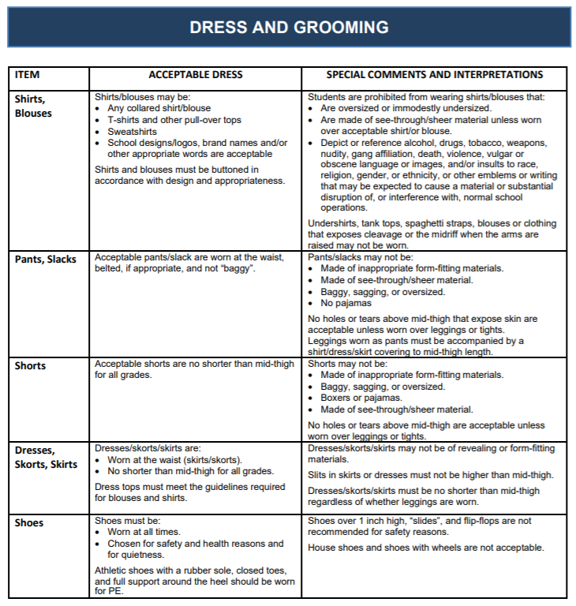
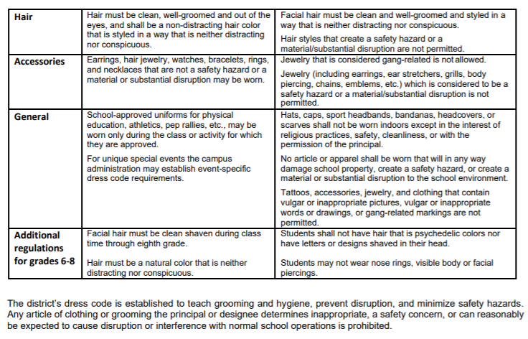
Student Dress Code

Slide 55
LJH Cell Phone policy
The following is the Lamar Junior High Cell Phone Policy:
In an effort to support student safety before and after school, Lamar Junior High students are allowed to possess cell phones on campus. Students must adhere to the following rules regarding cell phone use:
Cell phones must be turned off and cannot be visible on campus during the school day.
The campus is defined as: loading and unloading areas for cars and buses, in the building, or on campus grounds.
The school day is defined as, but is not limited to, before or after school, class time, passing periods, lunch periods, after school detention or tutorials, during emergency drills, practices for extracurricular events and field trips.
Placing a cell phone on vibrate or texting is not considered off and is prohibited.
Using a cell phone to record or video tape is prohibited.
Students are not permitted to possess ear buds, speakers, radios, MP3 players, video or audio recorders, DVD players, cameras, games or other electronic devices at school unless prior permission has been obtained by campus administration.
If a student is in need of making a phone call to parents or guardians, they may do so in the Front Office or in their Grade Level AP’s Office. Per Student Code of Conduct, a teacher may allow students to use cell phones for instructional use only and phones must be turned back off at the end of class.

Slide 56
LJH Cell Phone policy - Discipline
FIRST OFFENSE
The cell phone will be confiscated
At the end of the school day, student will meet with Principal to review Cell Phone Policy and the cell phone will be returned to a student.
SECOND OFFENSE
The cell phone will be confiscated and returned to a parent or guardian at the end of the day.
In accordance with Texas Education Code 37.082 a $15 administrative fee will be collected.
THIRD OFFENSE
The cell phone will be confiscated and returned to a parent or guardian after a mandatory parent conference.
Student loses the ability to exempt final exams.
In accordance with Texas Education Code 37.082 a $15 administrative fee will be collected.

Slide 57
Tardies
4 minute passing period
Dismissal from classrooms will be staggered.
Must be inside classroom
Absent after 15 minutes
Multiple tardies in a 6 weeks results in disciplinary action.
Occasional hall sweeps will be conducted.

