Slide 1
5th Grade
STAAR Parent Night
January 18, 2018
Hutchison Elementary
State of Texas Assessments of Academic Readiness

Slide 2
STAAR Testing Dates
Date | Assessment
April 10 | Grade 5 Mathematics
April 11 | Grade 5 Reading
May 14 | Grade 5 Mathematics (retest)
May 15 | Grade 5 Reading (retest)
May 16 | Grade 5 Science
June 26 | Grade 5 Mathematics (retest)
June 27 | Grade 5 Reading (retest)

Slide 3
Student Success Initiative (SSI)
Applies to students in 5TH Grade
Students must pass the STAAR reading and mathematics tests to be promoted to the sixth grade.
Students have three opportunities to pass. If a student does not pass one or both tests, the student must participate in additional instruction. (See SSI brochure for more information.)

Slide 4
STAAR Reading

Slide 5
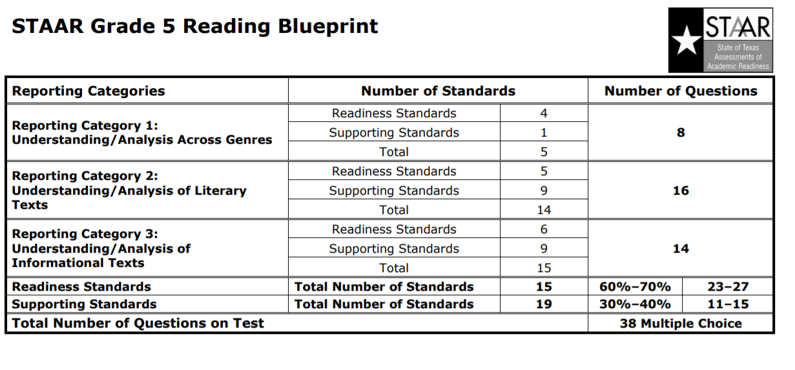

Slide 6
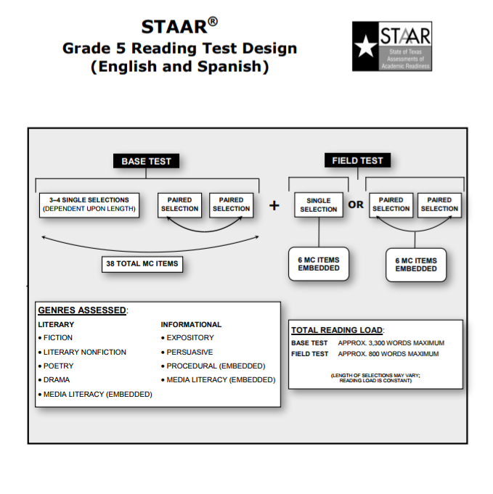

Slide 7
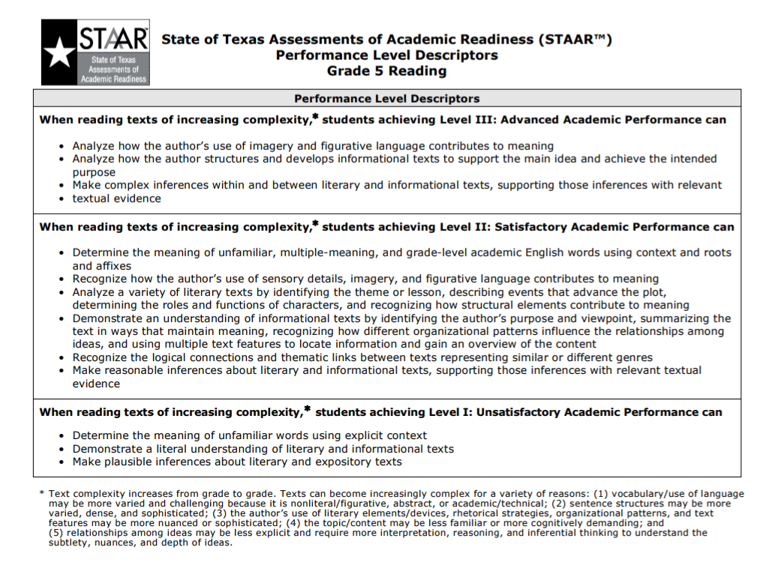

Slide 10
Reading Examples and Resources for Home Practice

Slide 11
5th Grade Math
STAAR Parent Night
January 18, 2018
Hutchison Elementary
State of Texas Assessments of Academic Readiness

Slide 12
STAAR Math

Slide 13
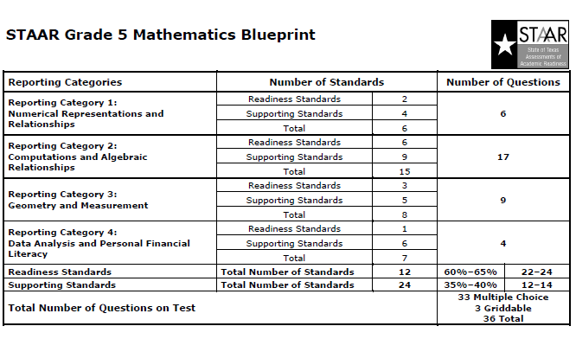

Slide 14
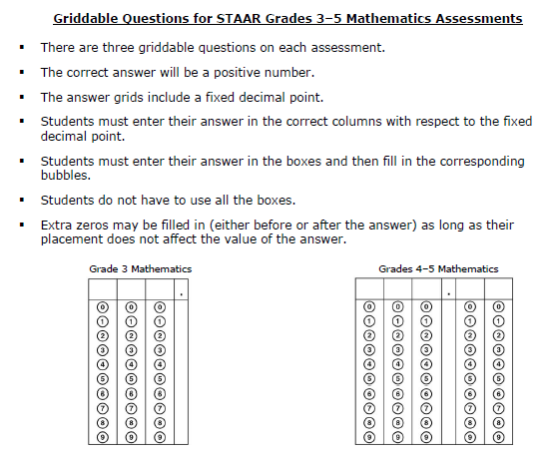

Slide 15
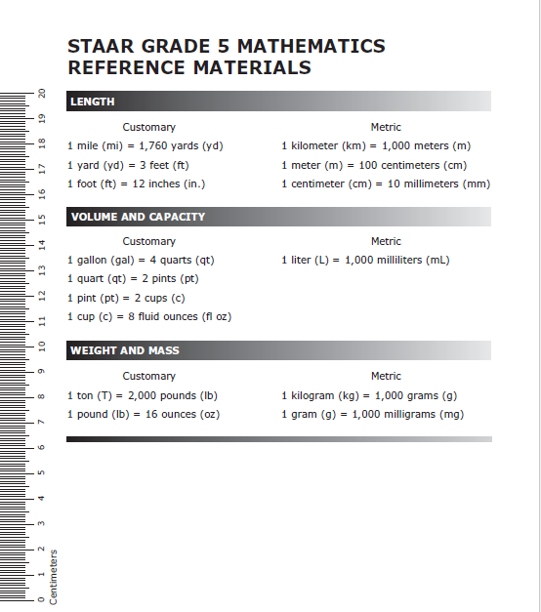
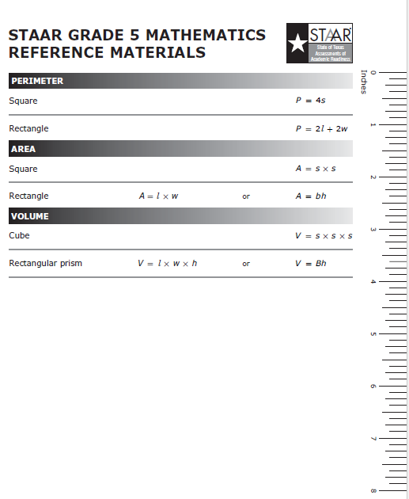

Slide 16
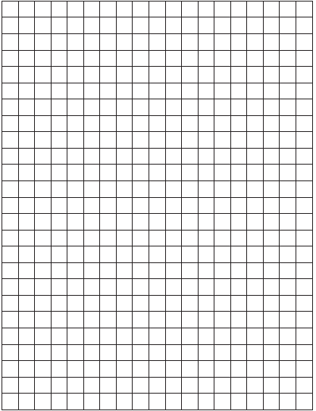
Centimeter Grid Paper
Ways to Use Grid Paper
Drawing models
Multiplication Tables
Place Value Charts
Area, Perimeter, Volume
Parallel and Perpendicular lines
Right Angle Checker
Graphing
Lining up decimals

Slide 17
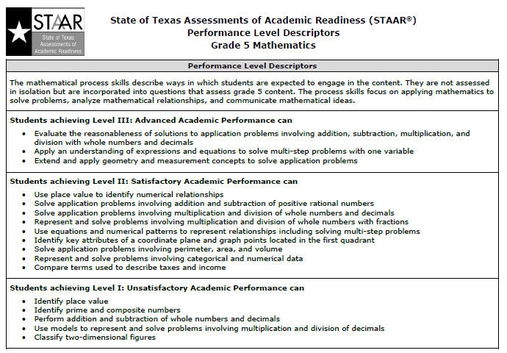

Slide 18
How Can You Help?
The TEKS focus greatly on conceptual understanding and fluency. By the end of 5th grade, students must be able to add and subtract whole numbers, decimals, and fractions fluently. Students must also be able to multiply and divide whole numbers, decimals, and fractions.
Multiply a three-digit number by a two-digit number
Divide up to a four-digit whole number divided by a two-digit whole number
Add, Subtract, Multiply, and Divide Decimals (up to hundredths)
Add and Subtract Fractions (like and unlike denominators)

Slide 19
Math Examples and Resources for Home Practice

Slide 20
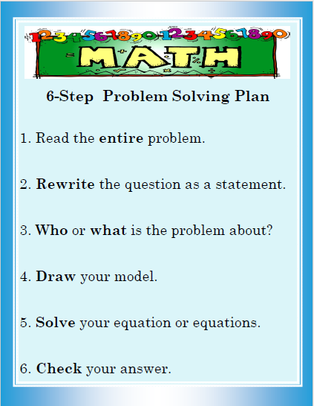
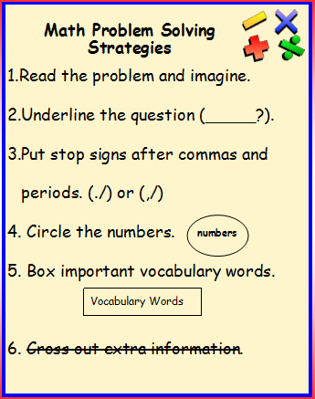

Slide 21
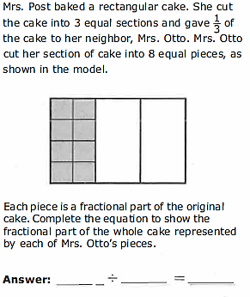
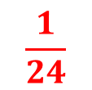
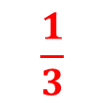

5th Grade Sample Question

Slide 22
Math Resources
Textbook tutorials - http://www-k6.thinkcentral.com (Students have been given a log in and password for online textbook that can be used at home)
Xtra Math – www.xtramath.com
Front Row Ed – www.frontrowed.com
Khan Academy: https://www.khanacademy.org/
TEKS Resource System – www.teksresourcesystem.net (click on parent resources)
TEA STAAR Resources: http://tea.texas.gov/student.assessment/staar/math/

Slide 23
Thank you for coming!

