Slide 1

Welcome to Dickinson Elementary
2022-2023
Learning is Timeless

Slide 2
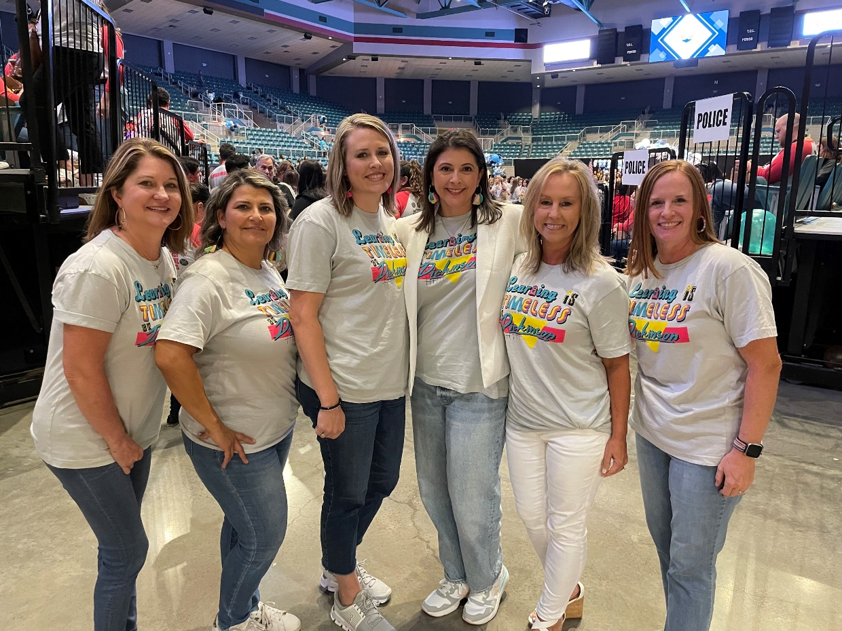
Meet the Instructional Leadership Team!
Principal: Channon Almendarez
Assistant Principal: Angela Peters
Counselor: Kathryn Reaves
Instructional Coach: Lisa Morrey
ESL Specialist: Yadi Salinas
Reading Interventionist: Beth Boudreaux
Librarian: Joanne Bromonsky (not in picture)

Slide 3

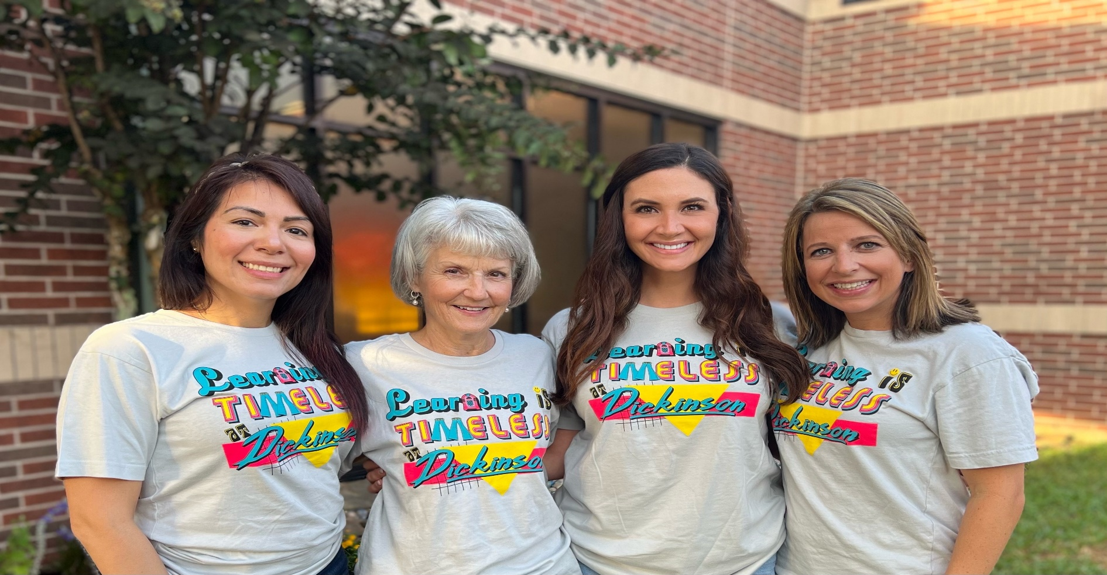
Ms. Meihaus
Ms. Ramon
Ms. Moeller
Ms. Gehring

Slide 4
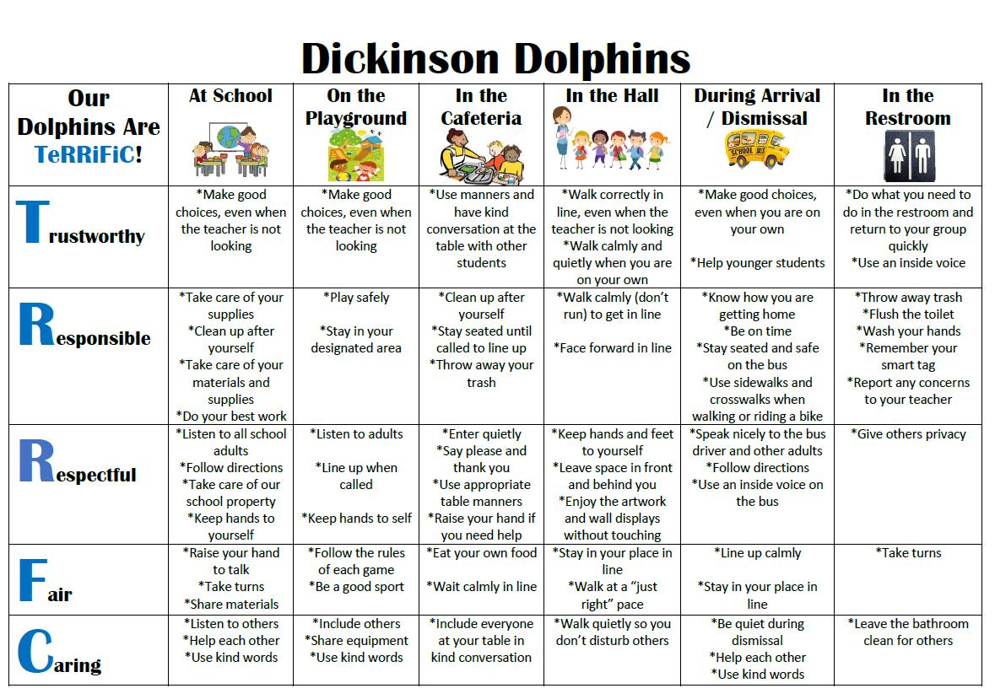
Expectations
(3 R’s)
-Be respectful
-Be responsible
-be ready

Slide 5
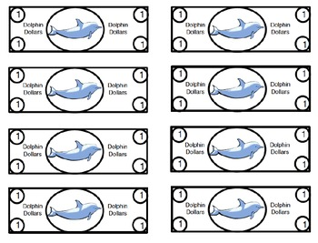

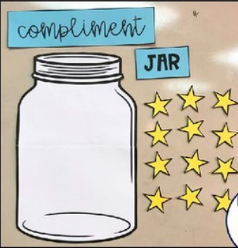

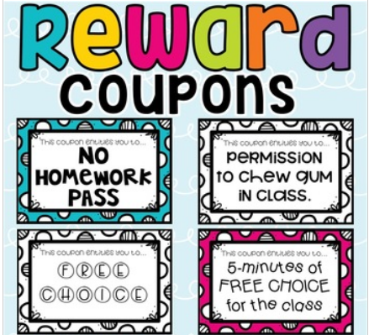
Classroom Rewards

Slide 6
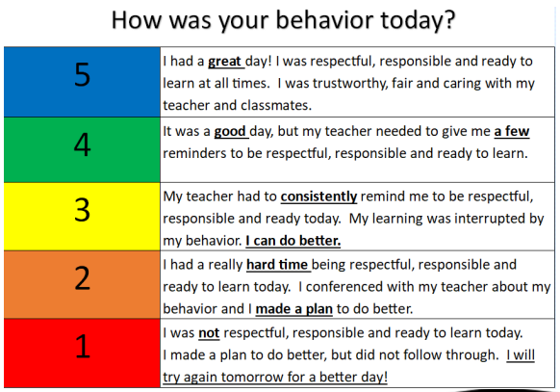
Discipline Procedures
Steps that will be taken by the teacher:
  Signal (hand gesture)
  Verbal reminder
  Private conversation with student
  Note on behavior chart in Daily Folder
  Note/email home

Slide 7
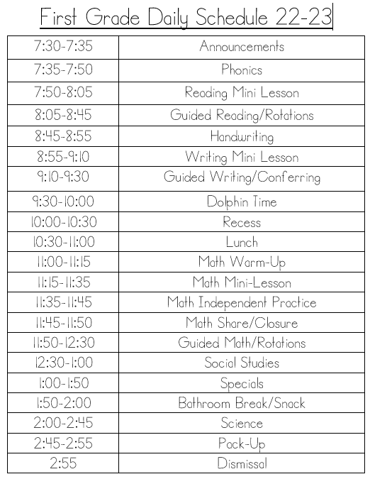
Daily
Schedule

Slide 8

Reading
  Story Elements (characters, setting, problem, solution)
  Retelling (beginning, middle, end)
  Making connections
  Making predictions
  Characteristics of Fiction vs. Informational text
  Informational text features
  Genres
  Poetry
  Sight Words

Slide 9
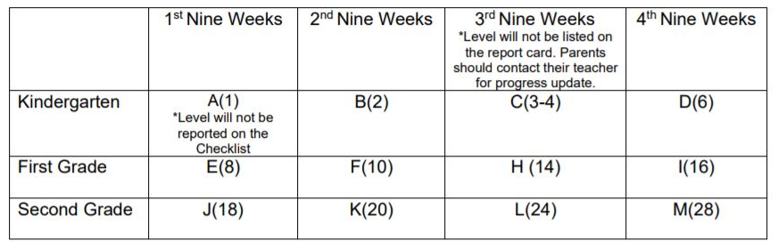
Guided Reading Assessment Levels (GRA)

Slide 10

GRA Level D

Slide 11
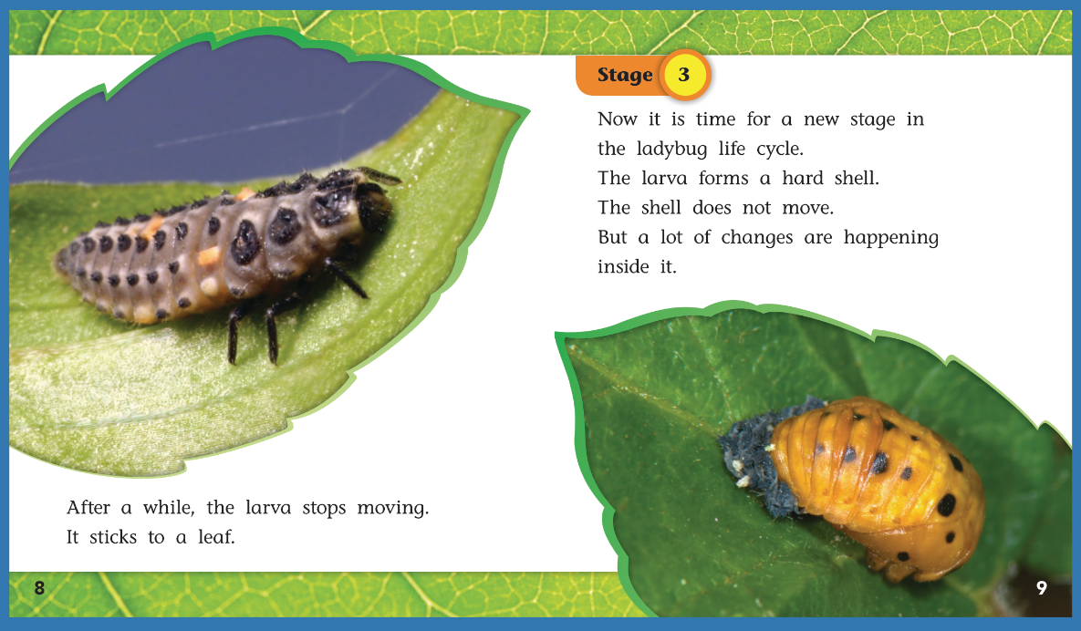
GRA Level I

Slide 12

Writing
  Personal Narratives
  How-to
  Informational text
  Imaginative/Creative writing
  Writing process
  5 STAR sentences
  Grammar/conventions
  Sight word spelling

Slide 13

Math
  Addition/Subtraction within 20
  Story problems within 20
  Skip counting (10s, 5s, 2s)
  Place Value to 120
  Representing numbers to 120
  Ordering numbers to 120
  Graphing
  Geometry (shapes and attributes)
  Telling time (hour and half hour)
  Money (coin value, and counting)
  Measurement (non-standard units)

Slide 14
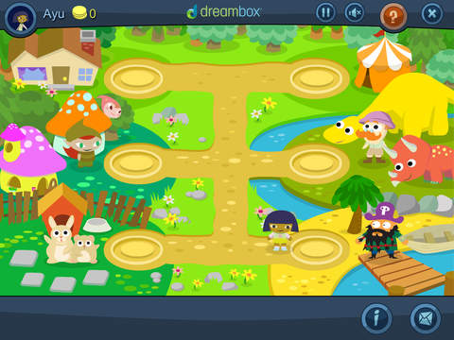

Dreambox
Dreambox is a math learning environment that adapts to your student’s needs.
Students see practice units and lessons dependent on how they perform on assessments.
Dreambox heavily incorporates manipulatives.
Since Dreambox is adaptive, teachers have little control over what unit students are working on.
Dreambox decides what skills your student needs to practice and when they are ready for new lessons.

Slide 15


How To Access Dreambox
To access on a PC,
your student needs to log in to ClassLink and click on the DreamBox icon.
To access Dreambox on an iPad,
download the Classlink app and the Dreambox app.
Login the Classlink app. Click on the Dreambox icon.
It will prompt you to launch the Dreambox app. The program will automatically open in the app.

Slide 16
District Expectation
FOR STUDENTS TO MAKE PROGRESS
IT IS RECOMMENDED THAT STUDENTS
COMPLETE 5 LESSONS PER WEEK.

Slide 17
TIPS FOR PARENTS
Encourage students to FINISH a full lesson.
Encourage them to use the
“Help” (K-8) and
Use only the program.
No pencil, paper, or calculator
Don’t help students answer problems.
Encourage a growth mindset. It is okay for students to make mistakes and try their own ideas!

Slide 18
WHAT INFORMATION IS AVAILABLE TO ME AS A PARENT?
Your Parent Dashboard allows you to see lessons/stories completed, tokens earned, a basic log of the time spent on DreamBox, a total time on task, and progress on curriculum categories.
To create a Parent Dashboard have your student log-in to his/her DreamBox account. Then, click Setup Parent Access at the bottom of the screen. Then, go to play.dreambox.com to see your Parent Dashboard.

Slide 19



Homework will begin Monday, September 26th.
2 days of reading (guided reading folder/iRead/Raz Kids)
1 day of math (fact fluency)
1 day of science (skill practice)
HW due every Friday

Slide 20

Grades
Math:
  minimum of 10 grades (8 minor and 2 major)
Reading, Language Arts, Science, and Social Studies:
  minimum of 7 grades (5 minor and 2 major)
Go to LCISD.org. Click “Family Access” to view your child’s grades at any time through Skyward.
  You can also adjust your settings to get daily/weekly grade alerts on skyward.

Slide 21
Reassessment Guidelines
A teacher shall provide corrective instruction and a reasonable opportunity to reassess failure to master TEKS on major grades.
The highest possible grade that can be earned and recorded on the reassessment is a 70.
The teacher will make a note in the electronic gradebook when grades are reassessments.
Minor grades, district exams, compositions, and student projects are NOT subject to reassessment guidelines.

Slide 22

Communication
Take-Home Folders
  sent home daily
  Contains graded work from the week before and papers from the front office at the beginning of the week.
  Please check these folders each DAY, review papers, and return the next day.
  expectation page inside – currently blue
  please check your child’s behavior form

Slide 23
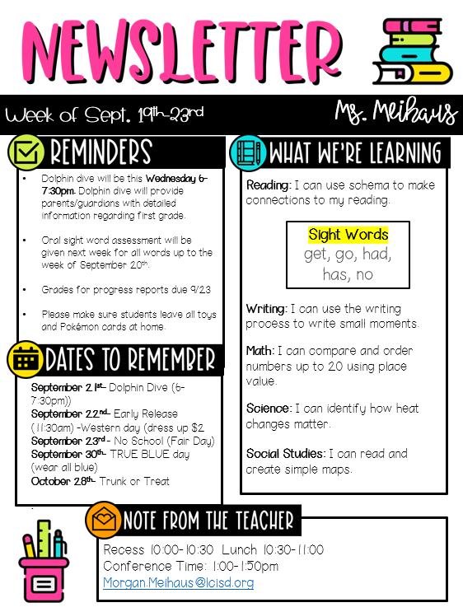
WEEKLY
NEWSLETTER
The newsletter will be electronically distributed every week through Canvas and/or Skyward.
Newsletters will include events, objectives, upcoming major grade dates, and other information deemed necessary by the grade level.
Please make sure that you are signed up and have access to Canvas.

Slide 24

Class Link
Access to free learning programs:
  DreamBox
  iRead
  Raz Kids
  Pebble Go
  BrainPOP Jr.
Use login information located in take-home folder. You can always access login info in skyward.

Slide 25


Classroom Snack
Students may bring one Healthy, easy to eat snack (Peanut free snacks).
things that will not stain fingers and papers.
Please Do not send juices and candy.
The only liquid allowed in class is water.
Please send filled water bottles each day that are spill proof.

Slide 26

Peanut Free
Classrooms
Classrooms are to be peanut free. A child with serious peanut allergy can potentially suffer a reaction merely by touching or smelling a food with peanut or peanut butter
Please do not send any peanuts, peanut butter or foods containing these items as snacks. They will not be allowed to be eaten in the classroom
Any food sent to share in classroom i.e., birthday cupcakes, cookies etc, is to be store bought, in original container with ingredient list that is peanut free
The above does not apply to lunches, children will still be able to eat food of their choice in lunchroom as we have ensured areas that will remain peanut free zones.
Thank you in advance for your cooperation. We are trying to ensure the safety of all of our children. We are striving to promote a safe environment for all of our students, and in working together we can work to keep our students safe.

Slide 27

Cafeteria Procedures
Return to regular pricing for lunch and breakfast.
We will begin selling snacks soon. They are extra. If you want to limit their snack purchases, please add that information to their online accounts.
You are always welcome to drop lunch off in the front office for your child.
Students need to wear their smart tags in order to expedite lunch.
Parents are welcome to eat at the first two tables.

Slide 28

How to purchase school lunch
Go to www.schoolcafe.com to create a lunch account online for your student
You may add money to their lunch account from your online School Café account
You may also apply for free or reduced lunch at www.schoolcafe.com

Slide 29

Birthday Treats
Birthday treat guidelines are in the 2022-2023 Elementary Student Handbook on page 24: Because of the time constraints, the treat is limited to one item per classmate, and it must be store purchased, single serve item (i.e. cupcake, cookie, etc.) so that it can be served, eaten, and cleaned up within a reasonable time.
The 2022-2023 Elementary Student Handbook states that gifts, balloons, treat bags, and flowers are prohibited at school. Invitations to individual parties may not be distributed at school. Thank you for your understanding!

Slide 30

Dickinson Dress Code
Collared solid navy blue, light blue, red or white short or long-sleeved shirt with no logo.
School spirit shirts and denim-type clothing will be permitted on Fridays:
Shoes: Safe for school, athletic shoes with closed toes and tennis shoes preferred.
Hair: Clean, well groomed, out of eyes, and non-distracting
Khaki, navy blue or black slacks, dresses, skirts, skorts, jumpers or shorts not of denim or denim-type fabric.

Slide 31
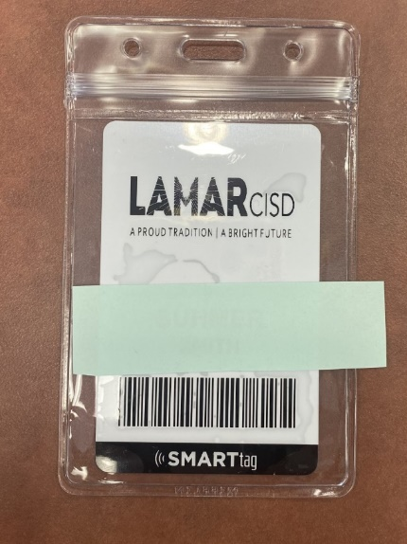
Smart Tags
Students are required to wear a SMART Tag each day: ​
track when a student is on the bus​
purchase breakfast and lunch​
check out books in the library​
safety procedures
Notes:
All students must wear their smart tags to and from school each day. They need them throughout the day for various reasons. If your child loses their tag, you may purchase a new one for $5. Send the money with your child and they will be ordered and delivered within 7-10 bus

Slide 32
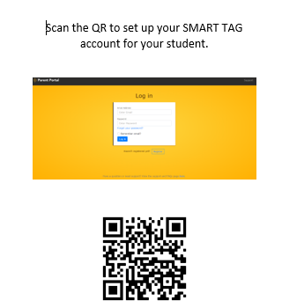

Register

Slide 33
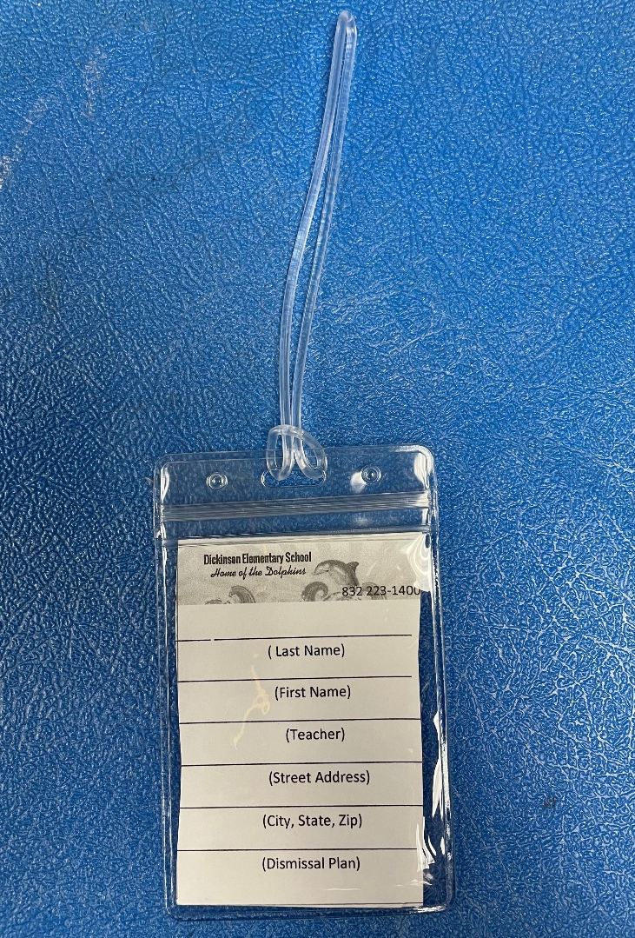
Please Leave on backpack!
Name & Dismissal Information
Replacement is $2
Dismissal Tags

Slide 34

Transportation Changes
Best practice is to send a written note to the school with your child and call the front office.
If you need to make a last-minute emergency change, call the front office prior to 2:00 PM.
832-223-1400
Please do not email any changes!

Slide 35
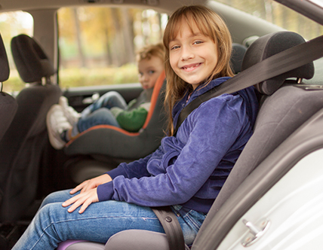
Car Riders
Students are picked up at the front ONLY.
The lines may be long, so pack your patience and cooperative spirit.
For the safety of the children, you may not park and walk up to get your child.
Car Tag-display your student number where it can easily be seen
Child needs to enter on the passenger side of car
Notes:
You may not drop off along the side. Less traffic between 7:00-7:15. Students should be ready to get out of the car. Parents that do not have car tags for pick up will be required to park and come in the school to be cleared to pick up the child.

Slide 36

Nurse Notes
All medication must be kept in nurse’s clinic—this includes cough drops
All medication must be in original container.
Over the counter, short term medications, such as cough drops or antibiotics also need appropriate paperwork, which can also be found on website under nurse’s notes and is called “Parental Permit to Administer Medication At School For 6 Weeks Or Less”
If your child has a life-threatening allergy or asthma, please get with Nurse Jarvis to discuss and provide appropriate paperwork and medication on campus for those “in case” moments for your child’s safety.
If you have any questions, please feel free to contact the nurse at 832-223-1406 or email at ajarvis@lcisd.org.

Slide 37

Absences/Attendance
Please arrive on time each day.
Morning bell rings at 7:30am.
If an absence is necessary, send a written note with your child the day they return in their daily folder.
Five or more consecutive absences requires a doctor's note.
Attendance is factored into our accountability rating.

Slide 38
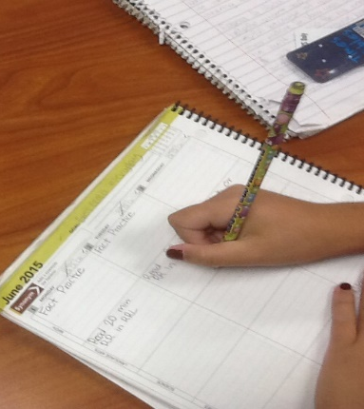
Students Head to class at 7:15 am
Students can unpack their backpack and get prepared for the day.
Allows them time to get focused for the day and be ready to begin learning.
The bell rings at 7:30 am. Students are considered tardy if not in class by the time the bell rings.

Slide 39
Every Day Counts!
1 or 2 days a week doesn’t seem like much but …
If your child misses. . . | That equals . . . | Which is . . . | And over 13 years of schooling that’s . . .
1 day every 2 weeks | 20 days per year | 4 weeks per year | Nearly 1-1/2 years of school
1 day per week | 40 per year | 8 weeks per year | Over 2-1/2 years of school
2 days per week | 80 days per year | 10 weeks per year | Over 5 years
3 days per week | 120 days per year | 24 weeks per year | Nearly 8 years

Slide 40
How about 10 minutes late a day? Surely that won’t affect my child!
He/she is only missing just . . . | That equals . . . | Which is . . . | And over 13 years schooling that’s . . .
10 min. per day | 50 min. per week | Nearly 1-1/2 weeks per year | Nearly ½ year
20 min. per day | 1 hr. 40 min. per week | Over 2-1/2 weeks per year | Nearly 1 year
30 min. per day | Half a day per week | 4 weeks per year | Nearly 1-1/2 years
1 hour per day | 1 day per week | 8 weeks per year | Over 2-1/2 years

Slide 41
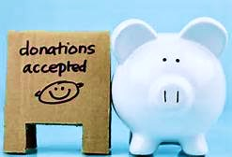



Dickinson Elementary PTO https://dickinsonpto.membershiptoolkit.com/Home
How you help your school?
“We make a LIVING by what we GET,
but we make a LIFE by what we GIVE. “ -Winston Churchill
Notes:
Parents & Teachers working together = successful students.

Slide 42

Thanks for being a great audience!

