Slide 1
Curriculum Night
2020-21
Kindergarten

Slide 2
FRIENDS
Better Together!
4th Grade

Slide 3
Welcome to Curriculum Night Kindergarten Teachers
Kathy Congram kcongram@lcisd.org
Basheer Khan basheer.khan@lcisd.org
Shelly Doherty sdoherty@lcisd.org
Keshia Hammond lhammond@lcisd.org
Natalie Stark natalie.stark@lcisd.org

Slide 4
Nine Week Behavior Expectations
Infraction chart by grade level:
Conduct grades will include infractions received for no homework. Office referrals will be counted as 9 infractions. Therefore, a student will receive no better than an “N” in conduct in nine weeks where behavior has resulted in an office referral.
Grade Level | Expectations
Kindergarten | S = 0-8 color changes/infractions N = 9+ color changes/infractions
All other grades 1st-5th | S = 0-8 color changes/infractions N = 9-12 color changes/infractions U = 13+ color changes/infractions

Slide 5
Kindergarten Grading Scale
S - Satisfactory - indicated achievement is within the range of expectations for the child's age and grade placement
N - Needs Improvement - indicates that the child is having difficulty in the skill areas marked
U - Unsatisfactory - indicates the child is having serious difficulty in the skills areas marked

Slide 6
Kindergarten Curriculum
Texas Essential Knowledge and Skills
http://ritter.tea.state.tx.us/teks
Integrates Reading, Language Arts, Math, Science, and Social Studies
Report card is based on mastery of 9 week Skills Checklist
Mid nine weeks progress report assessed after 4 ½ weeks of each nine weeks

Slide 7
Guided Reading
As part of our Balanced Literacy curriculum, teachers will differentiate reading instruction through Guided Reading.
Teachers will use assessment data to plan and adjust small group Guided Reading lessons. Groups will be flexible and will focus on specific strategies and skills needed by students.
Students will rotate between literacy-based activities, independent reading, and meeting with the teacher as part of our Reader’s Workshop approach.

Slide 8
Guided Math
Implementation of guided math consists of:
Whole group instruction: 3-4 days a week, primarily to introduce a new concept or topic
Small group instruction: 3-4 days a week so that teachers can effectively monitor student understanding and tailor instruction to meet needs of all students
Math workstations: 3-4 days a week during the guided math cycle
Fact Fluency: 3-4 days a week during the guided math cycle

Slide 9
LCISD Problem Solving Model
In mathematics, students continually use problem-solving, language and communication, and reasoning (justification and proof) to make connections within and outside mathematics. The LCISD problem solving model is a method in which students can read a problem, rewrite it, decide who or what the problem is about, draw a model and then solve the problem.

Slide 10
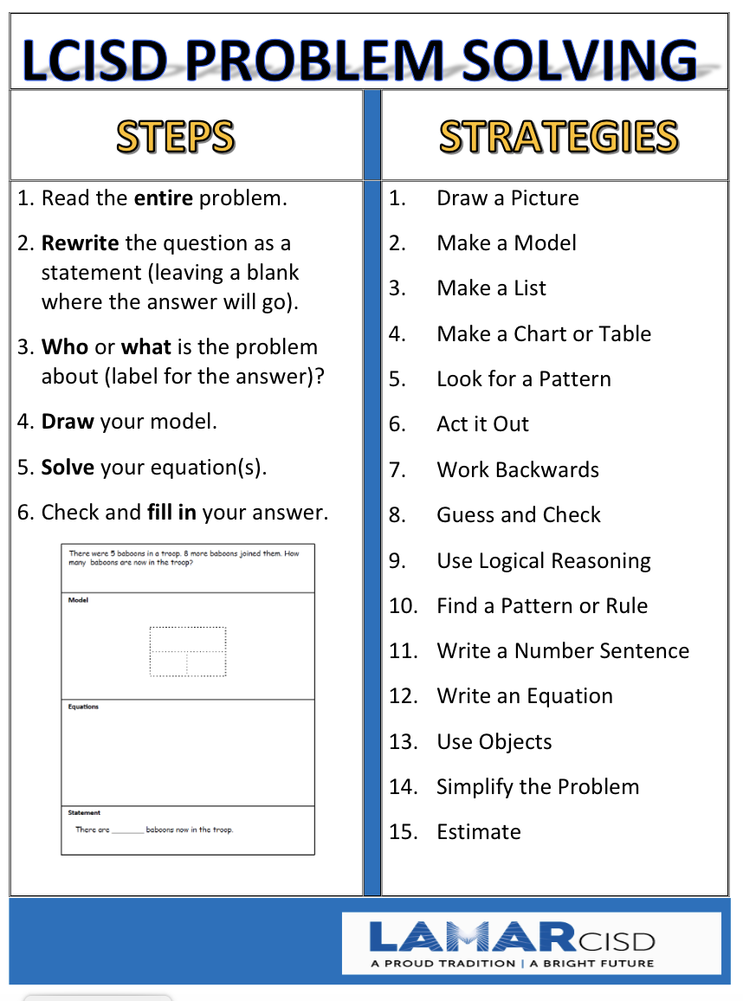

Slide 11
Problem Solving at Frost Elementary
At Frost, teachers will implement problem solving with fidelity.
Students will have time for guided and independent practice in the classroom.
In kindergarten, the LCISD Problem Solving Model will be implemented in whole group instruction using teacher demonstration of the process and student participation during the lesson.

Slide 12
Poetry Journals
Shared reading component of Balanced Literacy model (includes guided practice and independent practice)
Follow daily instructions
Reading skills and strategies
Rhyming skills
Sight words
Return each day

Slide 13
Kindergarten Word Study
Kindergarten will use Zoo Phonics as an adventure into reading, spelling and writing.
This approaches will provide students with opportunities to learn letters and letter patterns using movement and hands-on activities. The program is playful, brain-efficient, and concrete.

Slide 14
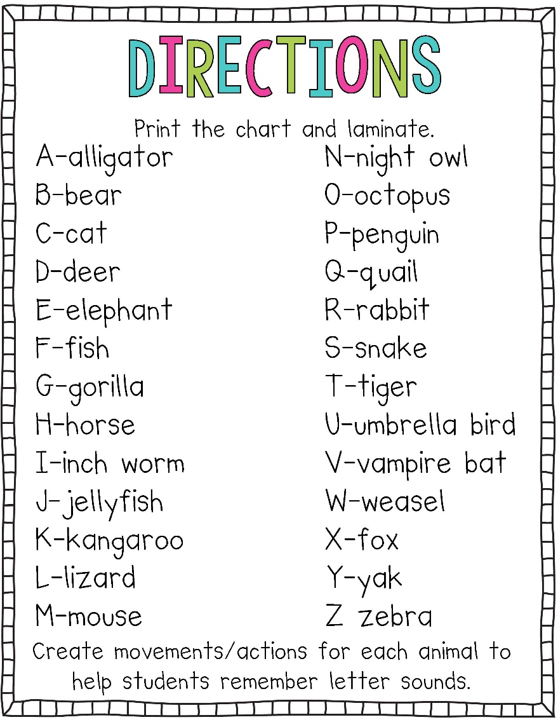
Kindergarten Word Study

Slide 15
Kindergarten GRA Reading Assessment
Teachers will administer the GRA reading assessment for the 2nd and 4th nine weeks.
Teachers will use running record assessments to determine reading levels for the 3rd nine weeks.
Reading levels will be reported on the report card for the 2nd, 3rd and 4th nine week grading periods.
Minimum Reading Levels for Kindergarten
1st Nine Weeks | 2nd Nine Weeks | 3rd Nine Weeks | 4th Nine Weeks
Not Recorded | 2 | Running Record 4 | 6

Slide 16
Raz-Kids
https://www.raz-kids.com/main/VideoLibrary/id/670
Soon all Frost students will have access to Raz Kids at school and at home.
Keep an eye out for log-in information in your child’s Tuesday folder.
Notes:
Play video to introduce families to Raz Kids.

Slide 17
ELEMENTARY Virtual Instruction
Zoom Expectations
Background distractions should be limited
Students should be dressed appropriately (LCISD Dress Code)
Students should have a work space with needed materials and should be sitting up during Zoom lessons
No toys during Zoom lessons
Virtual students must have video on and be muted during Graded Assignments, as Teachers are required to monitor
On Campus and Virtual students have the same number of Minor and Major Grades
Daily Assignments are for practice and reinforcement (do not contribute to grades)
.

Slide 18
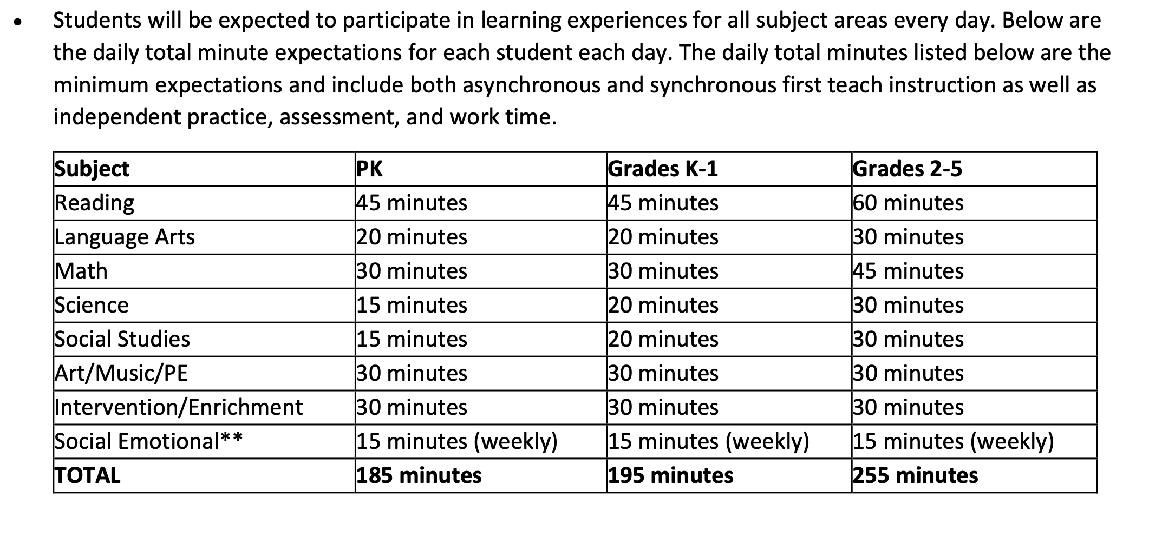
Sample Daily Virtual Schedule

Slide 19
Skyward Family Access
Allows parents to track student grades and progress
Go to www.lcisd.org and click on the Family Access button at the top of the page.
Sign in with your username and password.
Update all email addresses associated with your account.

Slide 20
Parent Conference Dates
Teachers will meet with parents to review student progress for the first nine weeks.
Virtual Conferences will be held on October 29th and 30th.
The first nine weeks report card will be distributed at the conference.

Slide 21
Snack
Afternoon snack is after 12:30 and happens in the cafeteria setting for safety purposes.
Please follow the approved snack list and provide small portions.
Snacks should be sent in zip-lock bags, including a napkin, and labeled with child’s name.
Please either open prepackaged bags at home or send snacks in zip-lock bags to allow students to be “independent snackers.”

Slide 22
Important Information
Daily Folder
Tuesday Folder
Please return ALL important papers in the Daily Folder, as this is checked daily. Papers returned in the Blue Tuesday folder may not be seen until the following week.
Weekly newsletter is available on the Frost web page - Newsletters, Select Grade Level, Select Date

Slide 23
Friend of the Week
A class mascot will visit your student during the school year.
Students will keep a journal of the mascot’s visit with his or his or her family.
Students should bring a poster and favorite items from home.
Class mascots are sent home on Friday and should be returned by Thursday.

Slide 24
Birthday Guidelines
In accordance with district policy, we discourage food being brought in by parents/grandparents for the following reasons: protect instructional time; student food allergies (peanut, gluten, eggs); student medical conditions (diabetes); liability assumed by person bringing in food
Foods brought in must be store purchased and individually wrapped
Flowers, balloons, pencils, invitations and any other treats in honor or recognition of a child’s birthday cannot be delivered or distributed at school.

Slide 25
Tardy Policy
Students are counted as tardy if they are not in the classroom by 7:30 a.m.
Students with excessive tardiness will be referred to the attendance committee for consideration of ISS and a home visit by the social worker.
Three or more tardies in a 9 week period will disqualify students from attendance awards.

Slide 26
Attendance Policy
Excused absences include Holy Days, death in the immediate family, medical appointments, and personal illness.
If absent, send a signed note on the day the child returns to school. Medical verification from a doctor may be required.
Parents of students with excessive absences will attend a meeting with the Attendance Review Committee.

Slide 27
On Campus Attendance
Official attendance taking time is at 9:30 a.m. each day
When absent, a student must bring a note signed by parent or medical professional giving the date(s) of the absence(s) and describing the reasons for the absence.
The absence will be documented as excused or unexcused.
A student absent for more than five consecutive days because of personal illness, must bring a statement from a doctor.
A student is considered tardy if they are not in the building by the 7:30 bell.

Slide 28
Response to On Campus Absences
Response to On Campus
Tardies
3 Unexcused absences Skyward parent letter & phone call
5 Unexcused absences Parent meeting with Attendance Review Committee
6 Unexcused absences Social Worker visit
8 Unexcused absences Parent meeting with Administrator (notification of truancy at 10 unexcused absences)
10 Unexcused absences Truancy filed
3rd Tardy Parent phone call
4th Tardy Detention at recess *Subsequent tardies will result in ongoing detention
5th Tardy Parent meeting with Administrator
6th Tardy Attendance Review Committee
7th Tardy In-school suspension
8th Tardy Social Worker Visit

Slide 29
*Virtual instruction students will be counted as present if they meet the criteria below for engagement. *Otherwise students will be counted as absent

Slide 30
Uniform Dress Code
Red, white, light blue or navy blue collared shirts & 2019-2020 Spirit shirts are allowed. Tops may not have any visible logos.
Viewable undershirts should be one of the uniform shirt colors.
Shirts purchased before 2020-2021 are not valid for the current school year. This includes Field Day shirts, 2015-20 Spirit Shirts, 2015-20 Club Frost Shirts, etc. and are not in dress code.
Sweaters and jackets must be solid red, navy, black, khaki or white.
Khaki, navy, black, blue denim slacks, shorts, skirts, skorts and jumpers are permitted.
School shirts and sweatshirts are allowed.
Leggings and tights should be red, black, blue, white or khaki.
No backless shoes, flip flops, overalls, hats, caps, scarves, skate shoes, sweat pants, or rolling backpacks are allowed.

Slide 31
Transportation Changes
If your child requires a transportation change, please send a note to the classroom teacher.
Do not email the teacher regarding these changes.
You may also call the front office but no changes will be made after 2:00 p.m.

Slide 32
Safety Awareness
A campus crisis team is in place at all campuses in the district. The Frost team consists of administrators, office staff and facilitators/specialists.
Campus Emergency Procedures Training was completed with the staff on 9/2/20.
District staff training is underway
Staff will complete district training requirements by 9/30/20
Blood Borne Pathogens
Child Abuse
Emergency Go Kit Training
Suicide Prevention
Bullying
FERPA - Confidentiality of Records
Texas Cybersecurity
Health Emergencies
Fire Drills will take place monthly
Additional drills are conducted each semester such as Lockdown, Duck and Cover, Evacuation, & Shelter-in-Place

Slide 33
Personal Items
Please make sure your child's name is on all personal items, such as supplies, lunch kits, sweaters, jackets, etc.

Slide 34
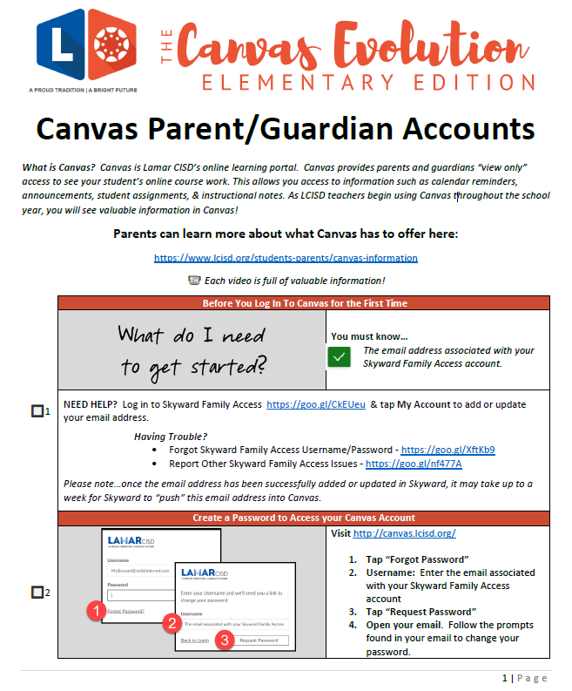
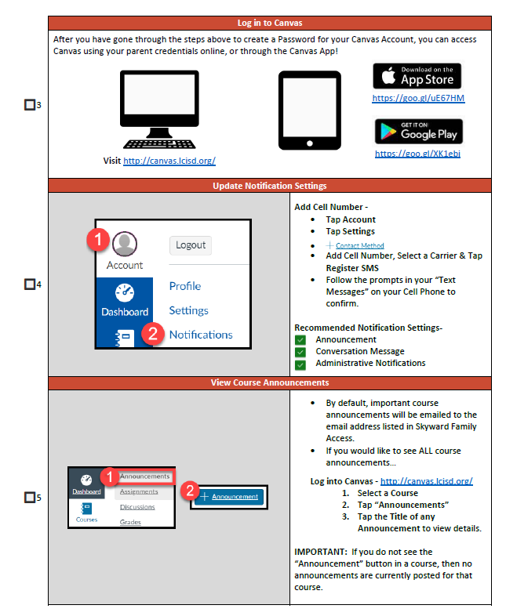
Newsletters
Newsletters can be accessed through Canvas this year. Canvas is the Lamar CISD online learning portal. Newsletters will be uploaded to Canvas as an announcement for you to view.

Slide 35
End of Year Awards
Good Citizenship Medal
(All S’s in Conduct)
Sight Word Medal
Science Expo Trophy

