Slide 1
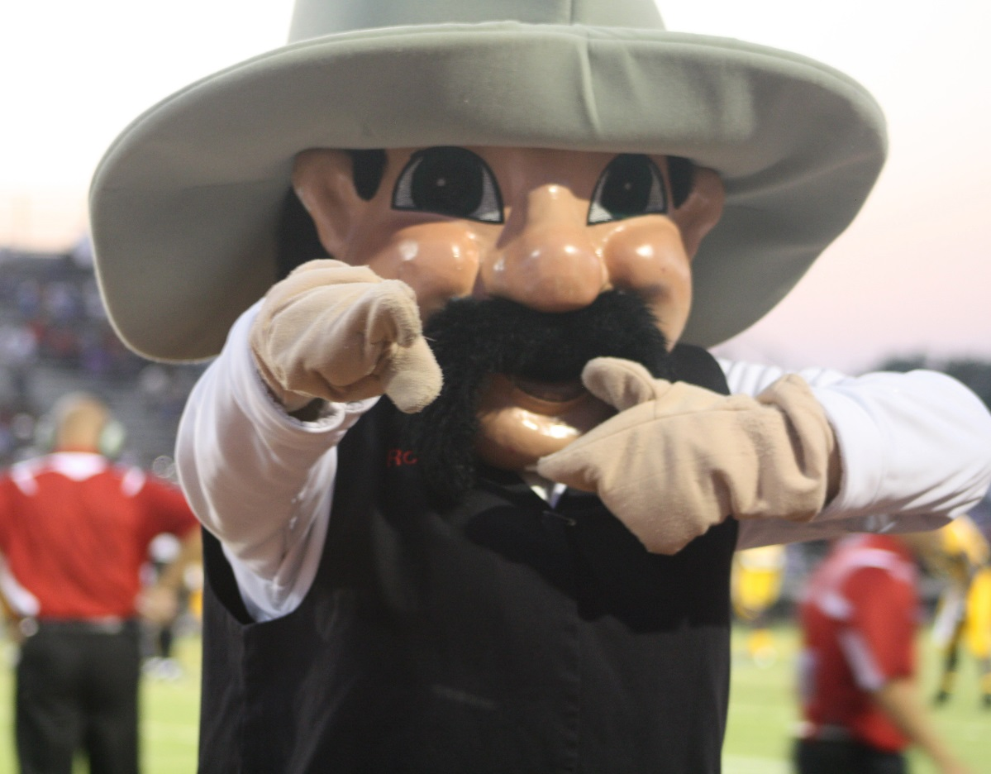
Welcome
B. F. Terry High School Rangers

Slide 2

THS Staff
Vera Wehring – Principal
Maria Fondon – Associate Principal
Assistant Principals
A-GL - Keschia Jones
Go-O - Jose Pineda
P-Z - Sean Riley
Counselors
A-E - Jan Payne
F-Lo - Patti Hodges
Lu-Ri - Kim Vogler
Ro-Z - Lezli Steffen
Brenda Teykl - Registrar
Adonica Williams – Instructional Coordinator
Allison Parker – College Career Facilitator
Amanda Hudson – Title 1 Coordinator

Slide 3
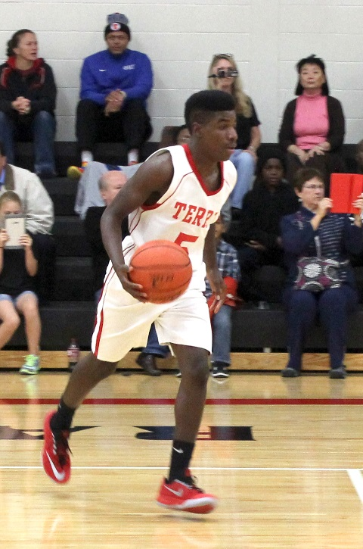

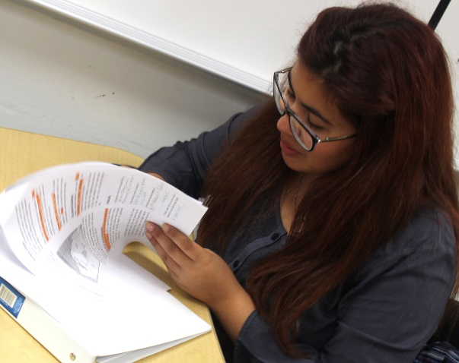
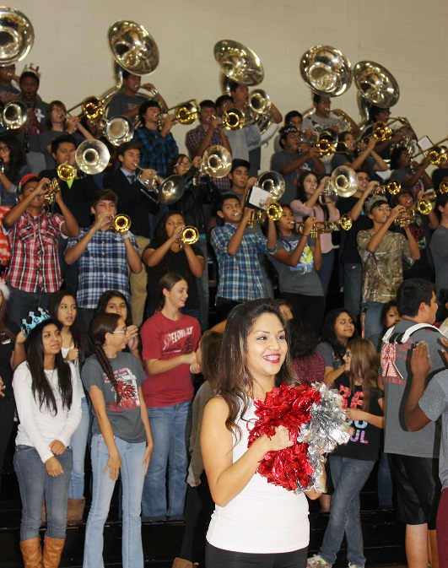

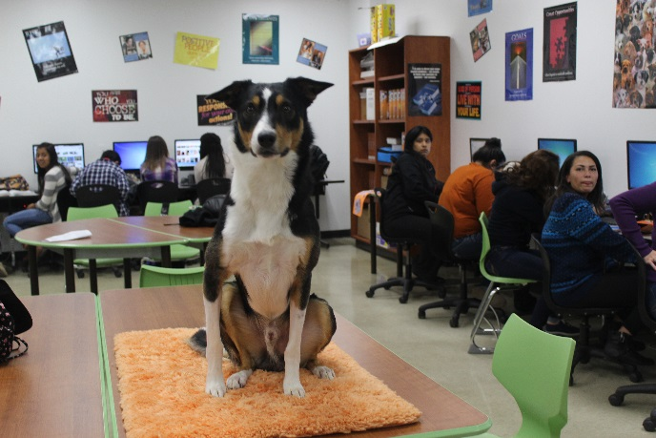
Life at Terry
Academics Athletics
Activities

Slide 4
Daily Schedule
Our day begins at 8:15 a.m.
8 classes in a day
4th or 5th period includes:
  Advisory
  Lunch(A,B,C,D)
Our day ends at 3:40 p.m.

Slide 5
GRADE LEVEL INFORMATION
Semester class: 1/2 credit
Full Year class(2 semesters): 1 credit
Grade Level Classification
9th Grade: 5.0 or less credits
10th Grade: 5.5 -11.5 credits
11th Grade: 12.0 -18.5 credits
12th Grade: 19.0 & above credits
Grading Scale
A = 90 - 100
B = 80 - 89
C = 75 - 79
D = 70 - 74
F = 0 - 69

Slide 6
Courses Designations
Academic
Pre-Advanced Placement (Pre-AP)
Dual Credit (Dual) - *Available Junior Year
Advanced Placement (AP)
Challenged but not overwhelmed – Placement determined by grades, STAAR tests and ReadiStep scores(SAT)

Slide 7
Class Rank
Based on Grade Point Average (GPA)
Cumulative - the semester average of all high school classes taken in grades 8-12
Derived by dividing the total number of grade points earned by the number of semester courses attempted
Updated annually, first rank provided during first six weeks of sophomore year
Available in the registrar’s office or online
Weighted GPA
Academic 1.0 90 x 1.0 = 90
Pre-AP/Dual 1.1 90 x 1.1 = 99
Select Articulated 1.1 90 x 1.1 = 99
AP 1.2 90 x 1.2 = 108

Slide 8



Homework
Expect your child to have
homework every night
BE CONCERNED - No books, no
homework, no assignments, no
studying for tests
Monitor study time
E-mail teachers
Schedule tutoring with teacher
Call if you have questions
Ranger Success Tu. & Thurs. in the Library and transportation available

Slide 9
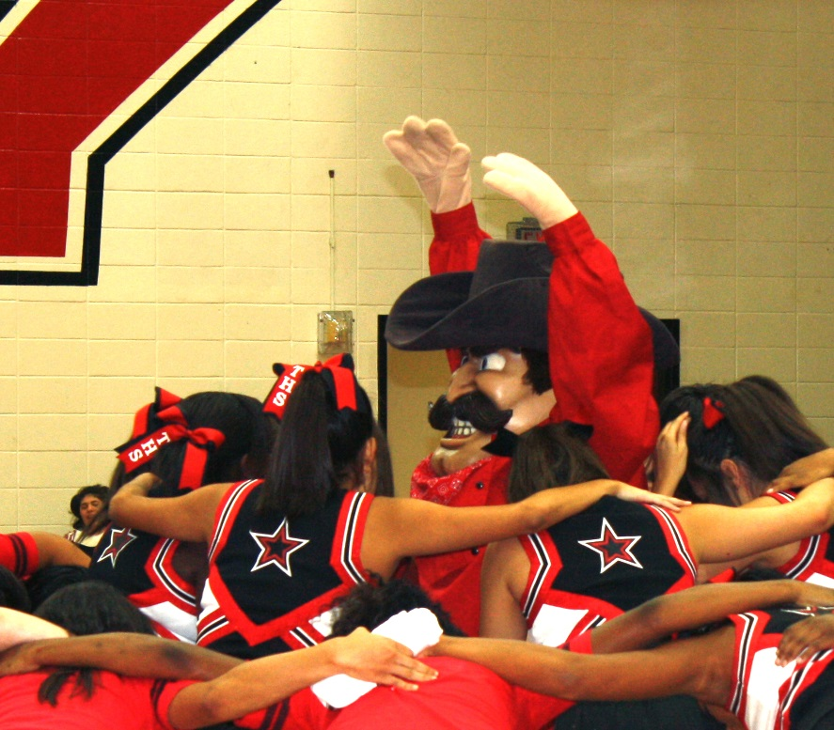
EXTRACURRICULAR ACTIVITIES
Fine Arts – Band, Choir, Drama, Art
Rangerettes
PALS
FFA
Athletics
Student Council
Academic Decathlon
National Honor Society
Debate/Speech
Service Cord
DECA
HOSA
Anime Club
Law Enforcers
Journalism – Yearbook- Magazine - Broadcasting
ROTC
USAB
Enhance your THS experience! Join a club/activity!

Slide 10


Sports offered at Terry
FEMALES
Basketball
Volleyball
Softball
Soccer
Track/Cross Country
Golf
Swimming/Diving
Tennis
Cheerleading
Wrestling
MALES
Basketball
Football
Baseball
Soccer
Track/Cross Country
Golf
Swimming/Diving
Tennis
Cheerleading
Wrestling

Slide 11
Student Success
It’s all about . . .
    Good Attendance
    Attentiveness, active participation in class, ask
    questions
    Put effort into your work ….. study, study, study
    Do your homework
    Meet deadlines
    Go to tutorials and take advantage of reassessment
    opportunities
    Balance academics and activities . . . manage time
    Be positive, have “I can do this” attitude

Slide 12
Graduation Requirements
Courses and Credits required
for graduation
STAAR Exams
    English I
    English II
    Algebra
    Biology
    US History

Slide 13

House Bill 5
Established new graduation plans for all incoming 9th graders in 2014-2015 and thereafter (optional for other high school students).
Post-Secondary and career readiness plan that supports individual student flexibility and choice.
Provides a pathway for two year college programs, four year college programs, certification programs, work force and military opportunities.

Slide 14
House Bill 5 in LCISD supports ...
Career Awareness/Exploration/Planning
Post secondary and career readiness
Continued high level of rigor and TEKS addressed in all classes
Graduation plans with established standards allowing for student flexibility and opportunity
Parental engagement/involvement

Slide 15
LCISD High School Graduation Plans
Distinguished Level of Achievement (DLA) – 26 Credits
Algebra II Required, FHSP+, Eligible for Top 10% Automatic Admissions
Endorsements – 26 Credits
1 Math and 1 Science
Endorsement Requirements
STEM
Business & Industry
Public Services
Arts
&
Humanities
Multi-
disciplinary
Studies
Foundation High School Program + Endorsement (FHSP+)
Algebra II Required
Foundation High School Program (FHSP)
22 Credits

Slide 16
LCISD Graduation Plans
 | Foundation Plan | Foundation + Endorsement Plan (DLA is the same in LCISD)
Discipline | Credits | Credits
English | 4 | 4
Math | 3 | 4*
Science | 3 | 4
Soc. Studies | 3 | 3
LOTE | 2 | 2
Fine Arts | 1 | 1
Physical Education | 1 | 1
Electives | 5 | 7
Total | 22 | 26
L*LCISD requires Algebra II for all Endorsements

Slide 17
House Bill 5 Endorsements
Arts and Humanities – 6 options
Business and Industry – 14 options
Public Services – 9 options
Science, Technology, Engineering and Math (STEM) – 5 options
Multidisciplinary Studies

Slide 18
Arts and Humanities Endorsement
Same Language
Two Different Languages
Same Fine Arts
Two Different Fine Arts
Social Studies
English

Slide 19
Business and Industry Endorsement
English
Animal Science
Welding
Interior Design
Construction
Arts, Audio/Video
Technology and
Communications
Finance
Business Information
Management
Culinary Arts
Computer Technology
Technology Applications
Marketing
Automotive Technology
Combination

Slide 20
Public Services Endorsement
Education and Training
Air Force Junior ROTC
Government and Public Administration
Health Science General
Pharmacy Technician
EMT
Medical Billing & Coding
Human Services
Law Enforcement
MT

Slide 21
Science, Technology, Engineering and Math (STEM) Endorsement
Computer Science
Mathematics
Science
Engineering
Combination

Slide 22
Multidisciplinary Endorsement
4 advanced courses that prepare a student to enter the workforce successfully or postsecondary education without remediation from within one endorsement area or among endorsement areas that are not in a coherent sequence
Four credits in each of the four foundation subject areas to include English IV and chemistry and/or physics
Four credits in AP or dual credit selected from English, math, science, social studies, economics, LOTE or fine arts

Slide 23

LCISD Endorsement Flow Charts
Courses required for each Endorsement can be found at www.lcisd.org under
There are 35 endorsement options for an LCISD student to chose to pursue
Many students will be able to complete more than one Endorsement

Slide 24


Business/Industry Endorsement
Manufacturing: Welding
8th – 12th
9th – 12th
Additional Elective
Courses
Principles of Ag, Food & Natural Resources
1 Credit
Principles of Ag, Food & Natural Resources
1 Credit
Agribusiness Management & Marketing
1 Credit
Agriculture Mechanics and Metal Technologies
1 Credit
Agriculture Mechanics and Metal Technologies
1 Credit
Ag Facilities & Design
1 Credit
Welding
1 Credit
Welding
1 Credit
Advanced Welding
2 Credits
Advanced Welding
2 Credits
Academic
Advanced/PAP/Dual
AP
Certification

Slide 25
Public Service Endorsement
Health Science: Medical Billing
Health Science
1 Credit
OR
Lifetime Nutrition & Wellness
.5 Credit
Medical Terminology
.5 Credit
AND
Course(s) not taken in Step 1 above
Medical Billing and Coding
(Medical Billing & Coding Specialist Certification)
1 Credit
Anatomy
&
Physiology
1 Credit
Medical
Microbiology
1 Credit
Academic
AND
Advanced/PAP/Dual
AP
Certification

Slide 26

STEM Endorsement *
PLTW: Engineering
8th - 12th Grade
Concepts of Engineering & Technology
1 Credit
9th - 12th Grade
Introduction to Engineering Design (IED)
1 Credit
Introduction to Engineering Design (IED)
1 Credit
Engineering Specialization Courses
1 Credit
Aerospace Engineering- LHS
Biological/Biotechnical Engineering- GRHS
Civil Engineering- THS
Computer Integrated Manufacturing- FHS
Engineering Specialization Courses
1 Credit
Aerospace Engineering- LHS
Biological/Biotechnical Engineering- GRHS
Civil Engineering- THS
Computer Integrated Manufacturing- FHS
Principles of Engineering
1 Credit
Digital Electronics
1 Credit
Principles of Engineering
1Credit
Digital Electronics
1 Credit
OR
OR
Engineering Design and Problem Solving: PLTW
1 Credit
Engineering Design and Problem Solving: PLTW
1 Credit
Academic
*Algebra II, Chemistry & Physics required for all STEM Endorsements
Advanced/PAP/Dual
AP
Certification

Slide 27
Endorsement Requirements
Students entering 9th grade in 2014 and thereafter must indicate their endorsement in writing via Skyward and parents should review and sign Endorsement choice via Skyward as well.
  If you have not digitally signed your child’s chosen Endorsement selection via Skyward, there will be an opportunity to do so during Course Selection
Students may choose to change their endorsement area and parents must be notified. Opportunities to change an Endorsement will be during specified timeframes.
Students can only choose to graduate WITHOUT an endorsement (Foundation plan only):
  After student and parents have been advised
  After sophomore year
  After parents or guardian files written permission

Slide 28
Benefits of choosing
“Your” Endorsement
Students will take courses that are most interesting to each individual student
Students are encouraged to take courses that support their post-secondary/career readiness goals
Create a seamless transition between high school and post-secondary/career opportunities

Slide 29
How will colleges recognize the
FHSP, FHSP+ and DLA
Graduation Plans . . .
Current data is not available on how colleges will recognize endorsements in the future or if/how students will be admitted to certain majors beyond college admissions
Colleges will continue to evaluate transcripts for the types of courses taken and grades earned, along with test scores and the academic/student resume

Slide 30
Performance Acknowledgements
Placed on diploma and transcript
May be earned by
  Dual credit (12 hours, grade of 80 or above)
  Bilingualism and biliteracy
  Outstanding performance on AP exams (score of 3 or higher)
  Outstanding performance on PSAT, ACT-PLAN, SAT or ACT
  Earning a nationally or internationally recognized business or industry certification or license

Slide 31
Endorsements
Declaring Endorsements

Slide 32
Log In to your Family Student Access;
Click on Endorsements

Slide 33
Click on “Update” button next to Endorsement in the upper left box.

Slide 34
Declared Endorsement and Declared Option
Select the Endorsement

Slide 35
What do the Declared OPTIONS mean?
Business & Industry
OPTION A: CTE
Animal Science Manufacturing: Welding Interior Design
Construction Arts, Audio/Video Tech Business Info Management
Finance Culinary Arts Info Technology Computers
Marketing Auto Technology
OPTION B: English (Yearbook, Newspaper/Magazine, or Broadcasting)
OPTION C: Tech Applications (DIM and Computer Science)
Public Services
OPTION A: CTE
Education & Training Govt & Public Adm Law Enforcement
Health Science Human Services
OPTION B: AFROTC

Slide 36
What do the Declared OPTIONS mean?
STEM
OPTION A: CTE (PLTW Engineering)
OPTION B: Computer Science
OPTION C: Math (5 total credits)
OPTION D: Science (5 total credits)
Multi Disciplinary
OPTION A: Advanced Courses
OPTION B: Four by Four
OPTION C: AP and/or Dual Credit (4 credits)
Art & Humanities
OPTION A: Social Studies (5 total credits)
OPTION B: Foreign Language (1 for 4 credits)
OPTION C: Foreign Language (2 different for 4 credits )
OPTION D: ASL (4 credits)
OPTION E: Fine Arts (Theatre, Dance, Band, Choir)
OPTION F: English (English electives)

Slide 37
Signing your Endorsement:
Read the “Signature Required” section and check the box next to “I Agree”. “Signed By” and “Date Signed” will be automatically populated. Click “Save”.

Slide 38
On the Endorsements page, you can now see your declared Endorsement and Option, and when you signed confirming that selection.

Slide 39
Parent Signatures
A Parent/Guardian needs to log in to their Skyward family access to electronically sign your declared Endorsement and Option. They need to “sign” by Feb. 3rd.
If parent does not know log in and password, they need to call main phone # for George Jr. High to get this info

Slide 40
Changes to Endorsements:
After you have electronically signed, any changes in Endorsements must have the ENDORSEMENT REQUEST CHANGE form completed by student, parent, and counselor.
Please see your counselor regarding ANY changes for Endorsements/Options.

Slide 41

Planning for your FUTURE
  Use the Course Selection Catalog to learn descriptions of courses
  Use the Endorsement Flowcharts to select sequenced elective courses
  Plan for courses that take 2,3,4, hours so you can get all your requirements completed
Use the CTE & Elective Course Offerings sheet to select other courses
Check for Prerequisite - # symbol- No Prerequisite

Slide 42
4 YEAR PLAN

Slide 43
Choosing Freshman Classes
English I
W Geography, W History or Human Geography AP
Math
Biology
______________
______________
______________
LOTE?
Fine Arts?
PE?
Endorsement course
Additional elective
Additional Considerations:
High School credit(s) earned in junior high
Academic skills
Interests
Future post-secondary/career goals
Appropriate course level

Slide 44
Course Selection
Timeline 2015-2016
Parent Presentations
    January 29th -- Ranger Preview (Current 8th Grades)
    February 9th -- Current 9th - 11th Grades
Student Presentations
    8th - January 27th & 28th - counselor verification – Feb. 2 & 3
    9th – Feb. 5th & 6th
    10th – Feb. 10th & 11th
    11th – Feb. 17th & 18th
Window Open in Skyward for Course Selections made and approved by students and parents – 8th grade – Jan. 28th – Feb. 3rd
  9th – 11th Feb. 5th – Feb. 23rd
Individual Conference with THS Counselor to review course elections entered and approved in Skyward by the student and by parents – Feb. 7th - March 27th

Slide 45
Family Access
Allows you to view student’s
  Attendance
  Grades
  Schedule
  Progress
  Assignments
  Sign Endorsement
  Make and approve course selections for 2015-2016
If you have any problems with access, please call Connie Alameda at GJH – Counselor Secretary and she will be glad to assist you.

Slide 49
Here’s how to reach us!
E-Mail
japayne@lcisd.org phodges@lcisd.org
kvogler@lcisd.org lsteffen@lcisd.org
Phone
(832) 223 -3415
This presentation is available on the Terry High School Website

Slide 50
Questions ? ? ?
Please call the Counselor Office
to schedule an appointment. We welcome parent conferences and look forward to assisting you and your child.
Thank you for joining us tonight!

