Slide 1
WELCOME TO NAVARRO MIDDLE SCHOOL!!
COURSE SELECTION FOR INCOMING 6TH GRADERS 2017-2018

Slide 2
Welcome to Navarro!
Stephanie McElroy, Principal
Bertha Alvarez, Assistant Principal
Tanesha Crockett, Counselor
We are here to serve you! Please do not hesitate to
contact us if you have any questions.

Slide 3
Navarro’s Mission
We are dedicated to success. Our commitment to the future reflects Pride, Achievement, and Respect.
Our goal is to introduce 6th graders to the changes that occur in secondary school in a safe environment.
Students will have more freedom, but with that freedom comes more personal responsibility.
High expectations for student academics and behavior.
We want you to leave Navarro stronger, smarter, and confident.

Slide 4
I Believe
Every child can learn and will be expected to do so
Every child should be challenged to meet their fullest potential
Every child should be given opportunities to explore their interests
Every child should feel safe coming to school and feel like there is someone here who they can talk to
Parents are the key to the success of students
The school and family must work together to ensure students are successful

Slide 5
Navarro is Growing and Changing
Since 2014, Navarro has shown significant growth in both Math and Reading STAAR scores.
In 2015, NMS earned a State Distinction for Postsecondary (College) Readiness
In 2016, NMS earned distinctions in Math and Closing Achievement Gaps
Projections for 2017 look great! We have made significant instructional changes, and our students are soaring to new heights.
Open door policy for parents, increased community involvement

Slide 6
Transfer Options
Because NMS did not meet State Standards in 2014, parents can opt to send their child to another middle school. This would only occur in 6th grade, and students will go to George JH for 7th.
Navarro met state standards in 2015, and in 2016, we not only met standard, but earned two academic distinctions. One in Math, and one for Closing Achievement Gaps.
By leaving NMS for 6th grade, students lose out on the opportunity to make social connections which will carry them through high school.
If you are considering transferring, I would be happy to meet with you to answer questions you may have about the direction Navarro is going and how we will help your child succeed.

Slide 7
Course Selection
NOTE:
To change images on this slide, select a picture and delete it. Then click the Insert Picture icon
in the placeholder to insert your own image.
This information presented is for the 2017-2018 school year to help you choose your elective for the whole year and some general info about 6th grade at Navarro MS.
Anti Bullying Week 2016

Slide 8
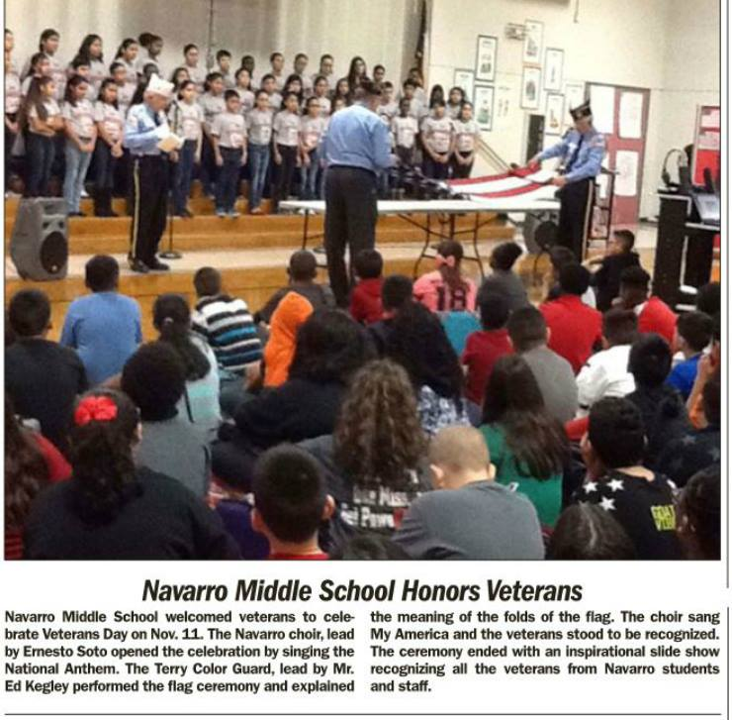
Navarro’s Schedule
Start time– 8:15
End Time- 3:30
7 Subjects (English, Reading, Math, Science, Social Studies, PE, Elective)
6 different teachers instead of 2
Elective Choices (Entire School Year)
Band
Orchestra
Choir
Theater Arts
Art

Slide 9
NMS DRESS CODE
No uniforms ☺
No inappropriate language/images on clothing
No earrings for boys – no large loops for girls
Finger tip length shorts, no spaghetti strap or short waisted tops, no tears in jeans, no leggings/jeggings, no transparent tops
No excessively large or baggy clothing
No bandanas or caps in the building, shoes must be tied at all times, no flip flops/sliders or house shoes
No extreme hair styles (mohawks, fauxhawks, unnatural colors, letters/designs/lines shaved in the head)
PE uniform required (can be purchased for $20)

Slide 10
Interesting info….
No regular backpacks allowed due to space– a zipper binder is all you need.
No Uniforms-LCISD Dress Code Enforced
We sell Navarro String Bags for students to use at school. They are $10.00 and can be purchased starting at Kick Off Camp.
7 Elementary Schools feed into Navarro Middle School (Bowie, Taylor Ray, Travis, Thomas, Beasley, Meyer, and Arredondo)

Slide 11
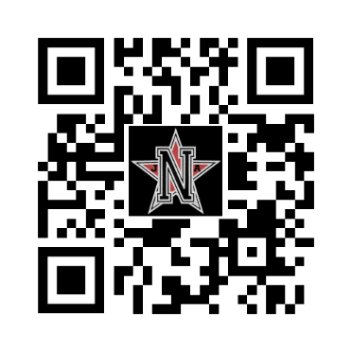
Ways We Communicate
Facebook: https://www.facebook.com/Navarro-Middle-School-428246717221978/
Navarro Website
Twitter:@NavarroMiddle

Slide 12
REMIND 101
Get Text alerts sent straight to your phone!
Send 81010
A text that says
@nms20172
Send it!

Slide 13
Behavior Campaign
Navarro
Navarro Volunteers are up to
P
A
R
The PAR Model will serve as our compass-- our guide and the heartbeat of our Behavior Intervention System. The students and staff of Navarro will model behavior that is up to PAR.
Guiding Question: Are your actions up to PAR?
ride
chievement
espect

Slide 14
Behavior Campaign
Navarro
Guiding Question: Are your actions up to PAR?
P
Pride: satisfaction with one’s achievement; the best of a group
FOLLOW UP QUESTIONS?
Do you take pride in what you’re doing?
Is your behavior the pride of Navarro?
RIDE

Slide 15
Behavior Campaign
Navarro
Guiding Question: Are your actions up to PAR?
A
Achievement: something done successfully because of effort
FOLLOW UP QUESTIONS?
What are you achieving right now?
What are you hoping to achieve? Are your current actions helping?
CHIEVEMENT

Slide 16
Behavior Campaign
Navarro
Guiding Question: Are your actions up to PAR?
R
Respect: to be admired because of ability, quality, or achievement
FOLLOW UP QUESTIONS?
Are your actions respectful?
How are you respecting _____? (the class, your peers, the school, me)
ESPECT

Slide 17
DON’T LIVE IN 3D
Navarro
Dishonest
Cheating
Disrespectful
Talking back
Anything that stops others from learning in the classroom
Disruptive
Banging/drumming/beating
Minor thief (up to $100.00 in value)
Damaging someone’s personal property
Slamming/throwing objects
Violating someone’s personal space
Making derogatory statements/ profanity towards peers
Yelling
Outbursts
Lying
Not speaking up when you witness wrong doing
Refusing to comply with directives
Being unprepared
Notes:
Talking Points: These are Level one violations that will be handle by the staff.

Slide 18
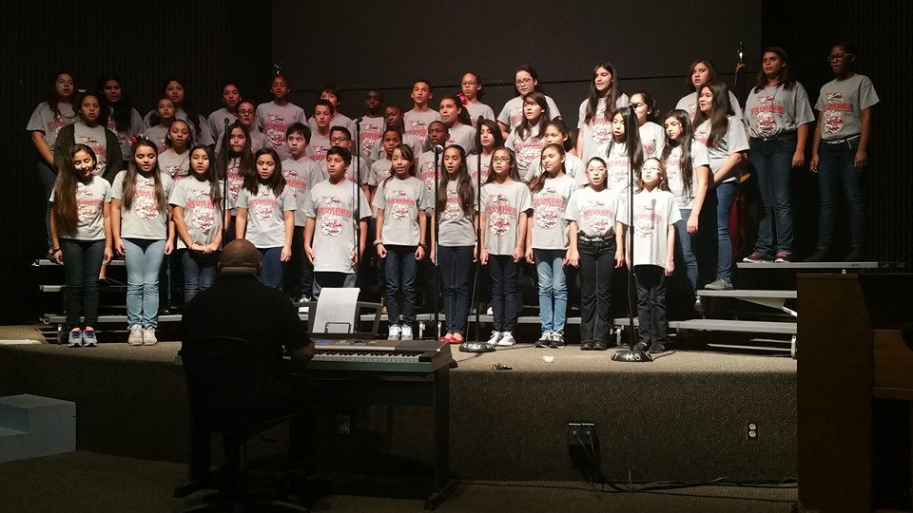
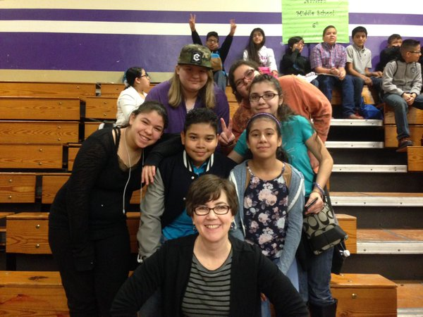
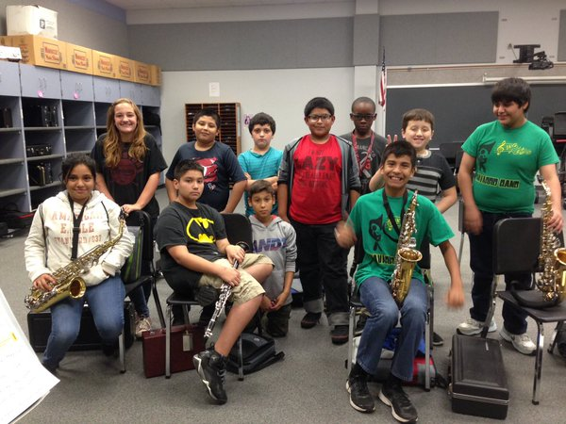
Activities at Navarro Middle School
Student Council
PALS with Terry High
Men Of Distinction
Modeling Excellence Dance every grading period
Honor Roll Club/Banquet
Arts and Crafts Club
Kick Off Camp-- August 8 & 9 2017
Character Education (Restorative Circles)
New in 2017- Orchestra!
Field Day in May
Field Trips
UIL Academic Competition
Spelling Bee
No Place for Hate
Clubs
Navarro GEMS
Father/Daughter Dance
Veteran’s Day Celebration
Muffins for Mom
NMS Choir
UIL 1st Place Music Memory Team
Saxophone Section NMS Band

Slide 19
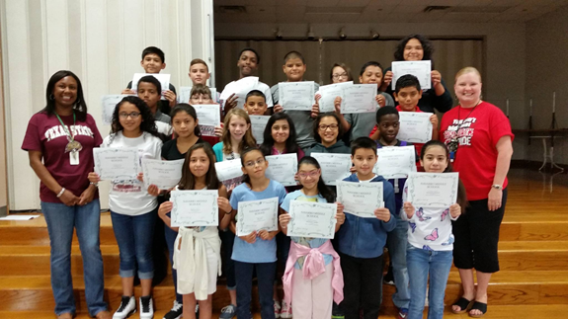
NEW in LCISD-Summer School
6th Graders who fail one or more core classes (ELA/Math/Science/Social Studies) for the school year.
6th Graders who fail STAAR Reading
6th Graders who fail STAAR Math
$100.00 per session
Attendance is required to go to 7th Grade.
P.A.R Students 1st Nine Weeks

Slide 20
All About Pre-AP
Grades 6 through 8

Slide 21
What is GT/Pre-AP?
A GT/Pre-AP curriculum, is a rigorous differentiated instruction that prepares students for AP coursework in high school.

Slide 22
Q and A: How will My ChilD be able to take PAP/GT Classes?
Students eligible for the G/T program are eligible for the classes automatically.
Students who have a profile of a successful AP student will also be automatically enrolled.

Slide 23
How will I know if my child has been enrolled in PAP classes ?
Shortly after you receive your child’s 5th grade STAAR results, a letter will be mailed to the parents of students who are auto-enrolled in PAP classes.
If you do not wish for your child to take PAP classes, you will have 3 school days to notify your child’s Middle School or Junior High Principal.
If you have not received a letter for auto-enrollment in PAP classes by June 6, 2016 you may call your child’s Middle School or Junior High Principal to appeal for PAP placement.

Slide 24
Examples of Reasons to Appeal
My child is new to the district this year (out of state or private school).
My child had lengthy illness and was not able to attend school this year.
Loss of an immediate family member.

Slide 25
Q and A: What does a “successful AP profile” look like when these students were in elementary school?
English Language Arts and Reading:
STAAR Scores: 92% or greater of questions correct. Student has Level III performance consistently within 2-3 questions of a perfect score. (3rd, 4th, and 5th grade STAAR scores)
Grades: 89% or better yearly average.
Average AP Score Outcome is a 3 to 4 when this student is in high school. (A “3” is a passing score on the AP exam.)

Slide 26
Q and A: What does a “successful AP profile” look like when these students were in elementary school?
Math:
STAAR Scores: 94% or greater of questions correct. Student has Level III performance consistently within 2-3 questions of a perfect score. (3rd, 4th, and 5th grade STAAR scores)
Grades: 94% or better yearly average.

Slide 27
Q and A: What about Science and Social Studies?
Students eligible in the area of PAP/GT Math will be auto-enrolled in PAP/GT Science.
Students eligible in the area of PAP/GT Reading will be auto-enrolled in PAP/GT Social Studies.

Slide 28
When is a child removed from PAP classes?
By parent request, when you sense your child is struggling or is frustrated in a manner that is not productive.
If a student is failing at the end of the 1st six weeks grading period, with a 69 or below, they will automatically be withdrawn from the PAP program in that subject.
Students who have a 70-75 at the end of the first 6 weeks grading period will have to bring their grade to a 76 or higher by the second progress report.
If a student is failing at the end of the first semester they will be withdrawn from that PAP class for the remainder of the school year.

Slide 29
How can you help your child prepare for 6th grade?
Ensuring they get plenty of rest and to school on time (8:10am)
Encourage them to meet NEW friends (This will be their graduating class of 2023) ☺
Maintaining open lines of communication is pivotal
Find an organizational system that works for them, they typically struggle to keep up with their supplies and pace of a secondary schedule.
Independent study skills/note-taking
Hold your child accountable for their work and behavior
Monitor their social media regularly
Be patient…these freedoms are new to them and takes some adjusting.
We want the best for them too, so let’s be on the same team!

Slide 30
Academic vs Pre-AP Decision
As you consider signing your student up for Pre-AP, please take these things into consideration:
Academic Classes
Pre-AP Classes
Academic classes are on the college prep track.
A fast paced curriculum consisting of 6-8th grade TEKS.
Academic classes have challenging and rigorous curriculum.
It is crucial that you talk to your student and investigate their readiness.
Very possible that an “A-B” student will earn lower grades
Additional homework/projects/study time after school will be required
No HS GPA credits are given a the 6th grade level for
Pre-AP courses.

Slide 31
Characteristics of a successful Pre AP 6th grader
Prepared for class with:
An open/growth mindset
Ready to meet NEW friends (blending of 5 campuses)
A positive attitude
Necessary supplies
Independent study skills/note-taking
Advocates for themselves/holds themselves accountable
Is proactive, and willing to ask for help when needed
Willing to ask questions to further their understanding of subject
o raise their hand for help when needed.
Asks good questions to further their understanding of the content.

Slide 32
Q and A: How do we make informed decisions?
Make sure you are informed about:
What makes a successful GT/Pre-AP student – work habits, support from home, internal drive.
What does the profile of a successful student look like?
What type of commitment from the student AND the parents support success?
What is expected in the differentiated curriculum? How much homework is there?
Notes:
Jennifer explain what homework differences students will experience and how that can impact extra-curricular activities..

Slide 33
What do you need to do right now?
There is NO ACTION to be taken right now for the incoming 6th graders with regards to Pre-AP course selection, as we must await the final 5th grade STAAR assessment data from the state in May/June.
This process gives our administrative team a chance to thoroughly review the incoming 5th grade STAAR scores to insure what students will meet the “Successful Pre-AP Profile” that is outlined in this PowerPoint.

Slide 34
The coming years are important and exciting ones for your student, and we look forward to supporting your family with a smooth and exciting transition from 5th grade to a successful 6th grader at Navarro Middle School!
http://www.lcisd.org/campuses/navarro/home

