Slide 1
Kicking Off into Second Grade

Slide 2
Meet the Team
Hillary Tyrrell htyrrell@lcisd.org
Tia Woodcock twoodcock@lcisd.org
Jamie Glassco jglassco@lcisd.org
Julie Lepper jlepper@lcisd.org
Julia Smith jmsmith@lcisd.org
Erica O’Donnell eodonnell@lcisd.org
Stacie Gutierrez sgutierrez@lcisd.org
Lauren Guevara lguevara@lcisd.org

Slide 3
Social Contract
Students will help the teacher create a social contract for the way they would like to be treated by others and the teacher in the classroom.
Students help the teacher manage the contract.
Some things that might be on the contract are:
Listen and follow directions when given.
Be prepared for class with all materials.
Keep hands, feet, and other objects to yourself.
Raise your hand and be recognized before talking.
Say and do only nice things to others.

Slide 4
Rewards
Students can earn Husky Bucks for good behavior, setting a good example, having homework completed and out on their desk first thing in the morning, and Random Acts of Kindness.
Husky Bucks can be turned into the homeroom teacher on Fridays before 8 A.M. for a variety of items and coupons.
Other rewards such as PAT (Preferred Activity Time) will be given as whole class rewards.
If a student has 0-4 conduct marks in a 9 weeks, they will be able to attend the Husky Hangout get together.

Slide 5
Husky Store Coupons
Treasure Box Item $10
Stinky Feet Pass $20
Furry Friend Pass $25
No Homework Pass (all subjects) $30
Sit by a friend at lunch pass $40
Computer Pass $50

Slide 6
Second Grade Discipline Plan
Second grade uses a clip/color change system. All students begin their day on green. The colors are as follows:
Gold-exceptional behavior
Green-good/followed the rules; “ready to learn”
Blue-first clip change down /”strike 1”-note written on behavior chart
Yellow-second clip change down/”strike 2”-note written on behavior chart
Red-third clip change/”strike 3”-note written on behavior chart/possible office referral depending of behavior
Individual Student Consequences:
Take Husky Bucks
Color change & Walk laps at recess-walk one lap for every color change
-blue: one lap
-yellow: two laps
-red: three laps
Note home

Slide 7
Conduct Grades
A calendar conduct chart will be placed in your child’s daily folder for each nine weeks. Please initial daily.
Conduct grades for individual categories for the nine weeks will be assigned as follows:
0 - 4 color changes = S
5- 7color changes = N
8 + color changes = U
Overall classroom conduct grades for the nine weeks will be assigned as follows:
6 total color changes equals an N.
9 total color changes equals a U.
Homework is part of the conduct grade.
Conduct in computer lab goes toward classroom conduct and not specials.
If a student receives a discipline referral to the office, their conduct grade can not be higher than N.
If a student receives more than one discipline referral to the office, their conduct grade will be an automatic U.

Slide 8
Communication
The student’s daily folder will communicate conduct and homework assignments daily. Please sign each night.
Our conference period is from 10:35-11:25.
Please send notes, call, or e-mail if there are any questions or concerns.
Teachers check e-mails before school, during conference, and after school. We will reply to e-mails as soon as we are able.
Please send notes for transportation changes or contact the office prior to 2 pm! Please do not e-mail transportations changes to the teacher!

Slide 9
Communication
Thursday folders will be sent home each week.
Weekly newsletters will be sent home each Friday in an email. Please make sure to provide your child’s teacher with your email address.
Grade level events, homework, and upcoming activities will be posted on the newsletter.

Slide 10
Daily Instruction

Slide 11
Daily Schedule
7:55-10:00 ELA Block
10:00-10:35 Math
10:35-11:25 Specials/Teacher Conference Time
11:25-12:30/12:45 Math continued
12:30-1:00 Recess (Smith, Woodcock, O’Donnell, Glassco)
12:35-1:05 Recess (Guevara, Gutierrez, Tyrrell, Lepper)
1:00-1:30 1st lunch (Smith, Woodcock, O’Donnell, Glassco)
1:05-1:35 2nd lunch (Guevara, Gutierrez, Tyrrell, Lepper)
1:30-2:20 Science/Social Studies
1:35-2:20 Science /Social Studies
2:25 Dismissal

Slide 12
Reading
Children will be instructed on their level using a reader’s workshop format, however they will be assessed at a 2nd grade level.
Reading comprehension activities will be given each week to practice reading strategies.
Rubrics will be used to assess student’s understanding of text. Readers and writers are always learning and growing, so to reflect this many of the rubrics go up to 95% as the highest score.

Slide 13
Reading
DRA2 will be used to assess reading levels.
This assesses the student’s reading accuracy, comprehension, and fluency.
Lamar CISD has determined expected reading levels for the end of each nine week period.
Students will also be assessed every 4 weeks with a reading passage and 10-12 questions.

Slide 14
Language Arts
Spelling –Spelling tests will be averaged each 9 weeks as one grade.
Listening and Speaking
Oral and Written Conventions
Writing
Research
This year we will be using the Writing Academy writer’s workshop format.
This format will guide student’s through a complete writing process.

Slide 15
Math
Students will work in small groups using manipulatives while engaged in hands-on activities.
There will be an intensive focus on problem-solving and application of basic skills.
Students will be tested after each 4 week period on new skills taught as well as objectives learned in prior weeks.
Fast fact quizzes will be given each week. All quiz grades will be averaged for one daily grade at the end of the nine week period.

Slide 16
Science
Students will participate in a science lab every other week. This lab will occur in the classroom. This is a crucial portion of the exploration process.
Students will be required to study vocabulary terms from their science notebook for tests.
We will post information on the grade level website regarding upcoming tests and interesting websites.

Slide 17
Social Studies
Students will participate in the exploration of maps, communities, and economics.

Slide 18
Specials
pe

Slide 19
Specials Information
This year, your child will go to art, music or PE on a weekly rotation. The schedule will be FIXED on Monday – Thursday to help your child remember which days to have the correct shoes for PE.
Fridays will rotate. However, if we have a Monday holiday, the instruction will always be made up the following Friday. Please check the Hubenak Home Webpage, or the PE Webpage weekly for information about the Friday schedules.
 |  |  | Second Grade
Pink |  |  | O’Donnell
Red |  |  | Guevara
Orange |  |  | Gutierrez
Yellow |  |  | Tyrrell
Green |  |  | Smith
Turquoise |  |  | Glassco
Blue |  |  | Woodcock
Purple |  |  | Lepper
First Check Out Your
Color Assignment

Slide 20
Now Check Out Your Weekly Schedule
 | Monday | Tuesday | Wednesday | Thursday | Friday
Art – Vogt | Pink | Turquoise | Orange | Purple | Schedule Will Rotate
Art – Hernandez | Yellow | Green | Red | Blue
Music – Ramsey | Red | Blue | Yellow | Green
Music – Perez | Orange | Purple | Pink | Turquoise
PE/Health* | Turquoise Green Blue Purple | Pink Red Orange Yellow | Turquoise Green Blue Purple | Pink Red Orange Yellow

Slide 21
Specials Policies
Content Grades in PE, Music and Art
Each student will receive two grades in art, music and physical education: academic performance and conduct.
Performance - Mastery of the instructional objectives will be the determining factor in assigning performance grades. Three grades will be taken during each 9-week period. At any point during the grading period that the student’s grade falls below an S, he/she will receive a progress report, or documentation on a specials conduct note, that should be signed by the parent and returned promptly. Please see page 50 of the LCISD student handbook for specific guidelines regarding specials assessment.
Conduct - Behavior will be used to determine the conduct grade. A student’s specials conduct grade is separate from the classroom conduct grade. Specials teachers will communicate conduct marks with a written note that will be stapled in the student’s agenda. Each note should be signed and returned promptly. Conduct grades are aligned with the grade level policies. They are as follows:
*Please note that specials grades are unique in that for both conduct and performance grades, students must participate actively and have a positive attitude to earn an S. Because these affect both conduct and performance, a conduct note may be used to communicate with parents when either grade may be lowered. (p.50 of the handbook)
Grades K - 2 |  |  | Grades 3 - 5
S | = 0 - 2 notes |  | S | = 0 - 1 notes
N | = 3 notes |  | N | = 2 notes
U | = 4+ notes |  | U | = 3 notes

Slide 22
PE Procedures
aRT Supply
Donations
Medical Excuses - If a student needs to be excused from participation in physical education activities for medical reasons, a written excuse from the parent must be provided if the student is to be excused for 2 or less days (only one PE day). If a student is to be excused from physical education activities for more than 2 consecutive school days (more than one PE day), please provide a written excuse from the doctor.
Appropriate Shoes – On days when your child has PE, it is extremely important that your child wears flat, rubber-soled, tennis shoes that are fixed firmly on their feet, cover the entire foot, and do not leave scuff marks on the floor. Your child will be running, jumping, and doing various other physical activities in their tennis shoes. Not only is this a huge safety precaution and a necessity to maintain the gym floor, but it is also part of your student’s PE performance grade. Each time your child does not wear the proper shoes to PE, he/she will receive a mark in the grade book. Three marks in a single 9-weeks will constitute a drop in his/her PE performance grade.
empty paper towel rolls newspaper magazines (please preview first) fabric yarn ribbon chenille stems cardboard posterboard fun foam cardstock plastic bottlecaps coke tabs old CDs wrapping paper bubblewrap unused sponges beads wax paper old calendars with visuals of animals, cars, etc. artificial foods such as fruits/vegetables
markers pencils
Questions? Please visit the Specials teachers’ websites!
See what’s happening and follow us on Facebook or Twitter!!
facebook.com/HubenakSpecials @HubenakSpecials

Slide 23
Grading
Reading:
On grade level work will consist of any work that the student is able to complete independently.
A minimum of eight(8 eight ) daily grades and/or quizzes will be taken each nine weeks.
A minimum of two (2) major grades will be taken each nine weeks, as well.
The report card grade will reflect a weight of 80% daily grades and quizzes and 20% major grades.
Language Arts, Math, Science, & Social Studies:
A minimum of eight(8 eight ) daily grades and/or quizzes will be taken each nine weeks.
A minimum of two (2) major grades will be taken each nine weeks, as well.
The report card grade will reflect a weight of 80% daily grades and quizzes and 20% major grades.

Slide 24
Grading
Numerical grades are required in reading, language arts, mathematics, science/health, and social studies for grade 2.
A Excellent progress. Work is consistently of above average quality. (90 – 100 %)
B Good progress. Work is above average. (80 – 89 %)
C Work is of average quality. (75 – 79%)
D Work is of poor quality; in need of improvement. (70 – 74%)
F Failure. Work is unacceptable ( Below 70 %)

Slide 25
Reassessment
A teacher shall corrective instruction and one reasonable opportunity to reassess failure to master the TEK/Curriculum in each daily grade. The highest possible grade that can be earned and recorded on the reassessment is a 70%.
The teacher will make a note in the electronic gradebook of the dates and grades of the reassessment.
A teacher shall provide corrective instruction and one reasonable opportunity to reassess failure to master TEKS/Curriculum on each test grade. Teacher will re-teach and allow students an opportunity to retest the objectives not mastered. The highest possible grade that can be earned and recorded on the reassessment is a 70%. The teacher will make note in the electric gradebook of the dates and grades of the reassessment.
Students whose rate of learning will not meet successful mastery of grade level material will have interventions monitored through the RTI process.
EXCEPTIONS: The following assessments are not subject to the reassessment guidelines: DRA, TPRI, and Running Records, student projects, and Elementary Common Assessments.

Slide 26
Success Assemblies
At the end of each nine weeks a Success Assembly is held.
Awards are given for Honor Roll, perfect attendance, and for character achievement as well.
Be sure to read the weekly emails from the Second Grade Team to find out dates and times for each assembly towards the end of each nine weeks.

Slide 27
2nd Grade Homework Policy
Reading
Required reading homework is 20 minutes per night, five nights a week and practice sight words.
Reading logs will be in their daily folder and must be filled out nightly.
Spelling
Nightly spelling homework will be assigned from the spelling workbook or teacher activity.
Math
Practice fast facts each night
5 to 15 problems on the week’s objective

Slide 28
FAMILY ACCESS CENTER
The Family Access Center allows for parents to log into a secure account and see each of their student’s assignments, grades, and averages.
This Family Access Center also allows for parents to see student’s daily attendance and messages from the classroom teacher.
To access the Family Access Center, parents will click on the Grades link on the main LCISD webpage.

Slide 29
Beginning of the Year Forms
Lamar CISD is piloting a program which will allow the beginning of the year’s forms to be submitted through Family Access. This year Hubenak is participating in the pilot.
All forms need to be submitted no later than September 11.
There is a video on the Family Access page of the district web site that walks parents through how to make changes. This is the direct link: https://www.youtube.com/watch?v=l53jXRi4ro8

Slide 30
Dress Code
Shirts: red, navy, light blue, white, or black collared shirts may be worn, as well as Hubenak t-shirts.
Students’ pants or skirts need to be blue or black denim, navy, or khaki. Jeggings are not allowed unless worn under a skirt. Athletic or sweat pant material is not an approved item.
Jackets and sweatshirt need to be in dress code colors and need to be solid colors with no decorations.
Any logos need to be a quarter size or smaller on clothing.
Shorts or skirts must be finger tip length or longer.
Shoes must be safe for recess and PE, and must have backs. (Flip –flops, backless shoes, etc. are not allowed.)

Slide 31
Celebrations
We will have 2 parties this school year: Winter Party and End of the Year.
Birthday treats are allowed. They must be store bought.
This can not take away from instructional time. We will set aside the last 5 minutes of the day for treats.
Invitations may not be handed out at school, however there is a form that came in your child’s Husky folder which will give permission for your home address to be given out so that invitations can be mailed.
You can indicate that you do NOT want your child on the birthday list.

Slide 32
Morning Procedures
Students may begin to arrive at 7:00 am. Student supervision is not provided prior to 7:00 a.m. Please do not bring your child to their classroom in the morning or drop them off in back of the building.
Students are to go to the Gym prior to 7:30 a.m. and will work on a math sheet.
Students are then walked to their classroom at 7:30.

Slide 33
Dismissal
Dismissal Time is 2:35 p.m. All changes in transportation must be made before 2:00pm. Please contact the front office with any transportation changes.
Parents are to pick up students in the car line. You must have your green sign. Please hang it or hold it up so Mrs. Wheeler can read your child's name easily.
Please do not come to the classroom, or bus ramp to pick up students.

Slide 34
PTA
The Hubenak PTA provides a lot of support for our students. One of the wonderful things PTA does, is provide $8 per student for a field trip. Without this funding, we would not be able to go on field trips.
Membership is only $10.50 per person. We encourage both parents to sign up.
Please join this evening if you have not all ready done so. ☺

Slide 35
Attendance and Tardy Policy Hubenak Elementary
2015-2016

Slide 36
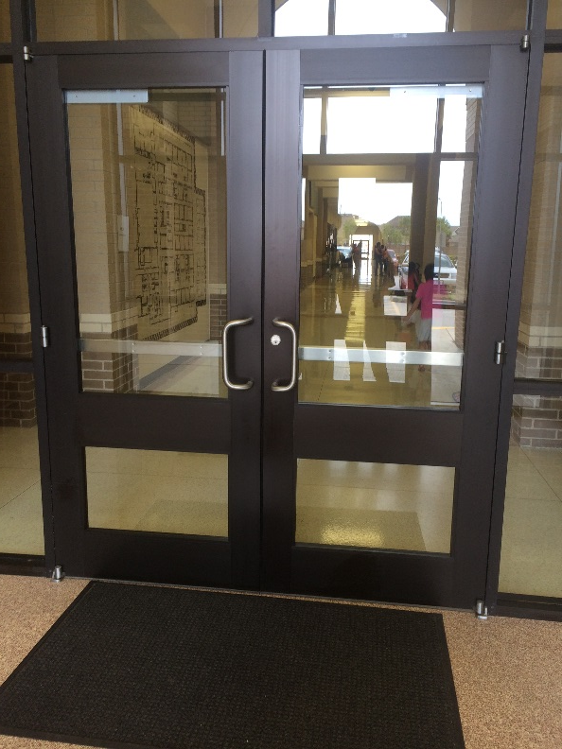
How early can students get into the school building?
At 7:00am the doors are open for students to come into Hubenak

Slide 37
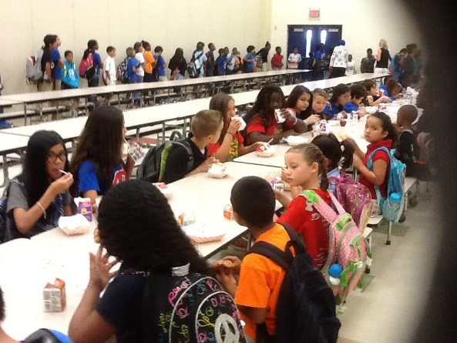
Advantages for being on Time
Students have time to eat breakfast for $1.15 if they chose.

Slide 38
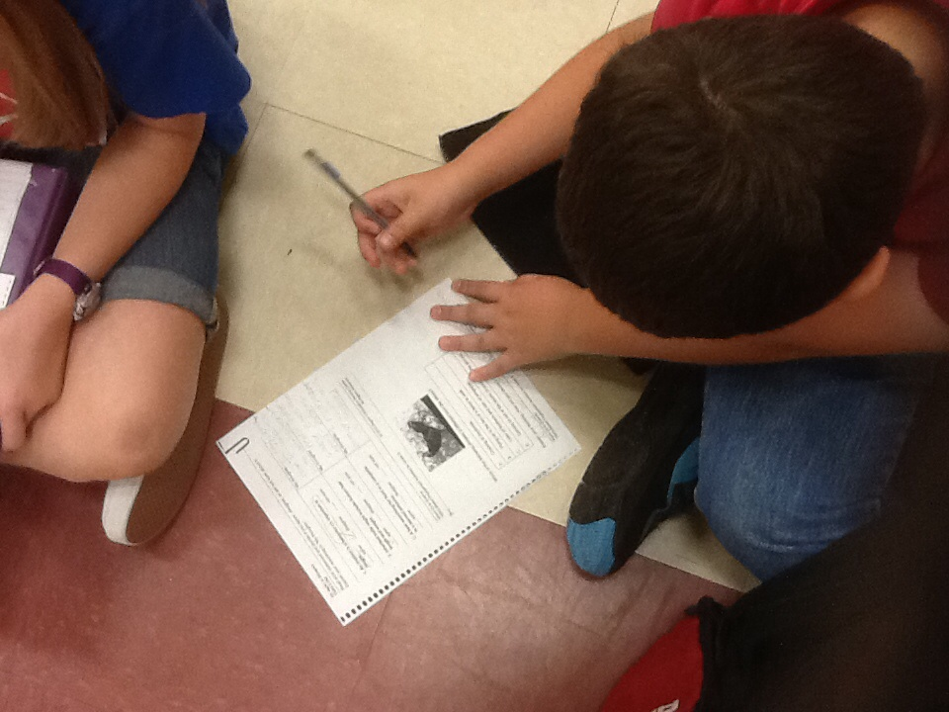
Advantages for 2nd-5th Grade
Students have the opportunity to complete their morning work in the gym.

Slide 39
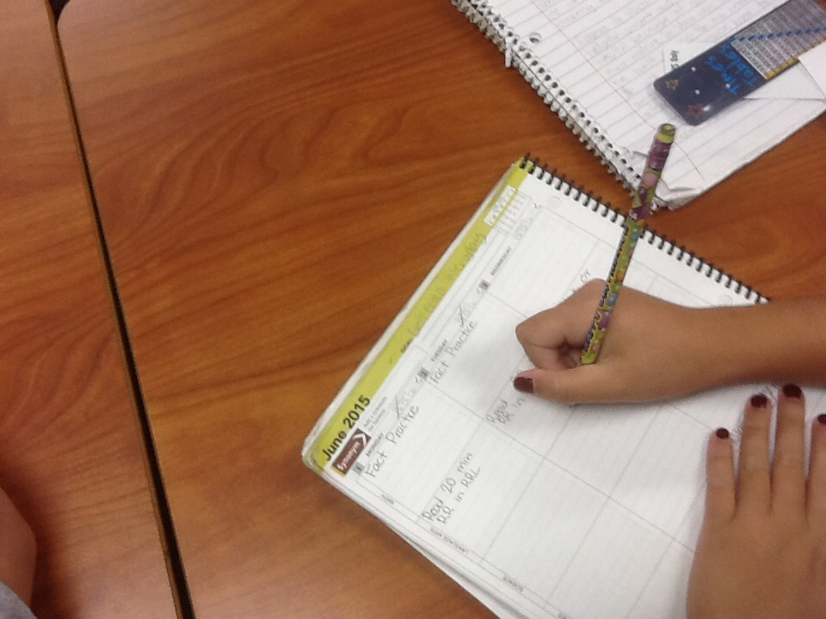
Students go to class at 7:30 am
Students have the opportunity to unpack their backpack, get prepared for the day, and write down their homework.
Allows them time to get focused for the day and be ready to begin learning.

Slide 40
Absences from School
If your child is absent from Hubenak, please send a note to the teacher about the absence.
Be sure to include: the first and last name of your child, date, grade level, teachers name and reason your child was absent.

Slide 41
Excused or Unexcused Absences?
When your child is absent it will be listed on their report card as an unexcused absence until they reach 8-9 absences. The Attendance Review Committee will then invite you in for a meeting so you may discuss the absences with them. After the meeting, the committee will decide if the absences are excused or unexcused.
Exception—Doctor’s notes are considered an
excused absence.

Slide 42
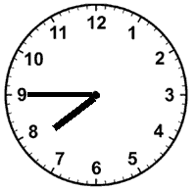
Tardy Bell and Policy
The tardy bell rings at 7:45am.
Students are tardy if they arrive at school at 7:45am and are not through the double doors at the front of school.
Students who are tardy lose valuable class time as the other students have already completed morning work, unpacked, written down homework, and watched announcements for the day.

Slide 43
Students who are Tardy
Must stop by the office and pick up a tardy pass
Are starting their day behind because by the time they arrive in class their teacher has already started teaching

Slide 44
Tardy Policy
First Tardy- Warning
Second Tardy- Lunch Bunch
Student sits quietly and eats their lunch
Third Tardy- Recess
Teacher choice recess activity

Slide 45
Tardy Policy Continued
Fourth Tardy-Detention with classroom teacher after school
Fifth Tardy- Meeting with administrative team member
Every Tardy after the fourth tardy will be detention with the classroom teacher.
Tardies start over every 9 week period.

Slide 46
How can you make sure your child is not tardy?
Have them ride the bus

Slide 47
Perfect Attendance
Students have the opportunity to earn a perfect attendance award each 9 weeks.
We understand that a student may be late occasionally. Students, therefore, may receive perfect attendance for being at school daily and having only had 1 tardy.

Slide 48
Drop off/Pick up Map

Slide 49
Miscellaneous
Students will be given two snack breaks throughout the day.
Parents, please remember that all snacks that are consumed in the classroom must be peanut/tree nut free. Students can bring peanut products to eat in the cafeteria at lunch but NOT in the classroom.
Students can bring a water bottle, provided it has a screw or sports top.
If there is a medical or religious reason your child can not drink milk, please provide a note to the school nurse and we will proceed accordingly for each particular situation.
No rolling backpacks or mechanical pencils please.
All parents must sign in at the front office when entering the building.

Slide 50
Author Visit
Books available for purchase.
See Mrs. Digoy, the librarian, for order forms or from the email sent by homeroom teachers.

Slide 51
Thank you for coming!

